Slide 1
Communicating with Data – More Advanced Tableau
Dr. Ab Mosca (they/them)
Slides based off slides courtesy of Jordan Crouser (https://jcrouser.github.io/)

Slide 2
Plan for Today
Working with multiple datasets
Customizing the look of a visualization
Working with filters
Conditional backgrounds
Details on demand (external resources)

Slide 3
Want to follow along?
Everything used in this demo is available in superhero-demo.zip under in-class on the course website

Slide 4
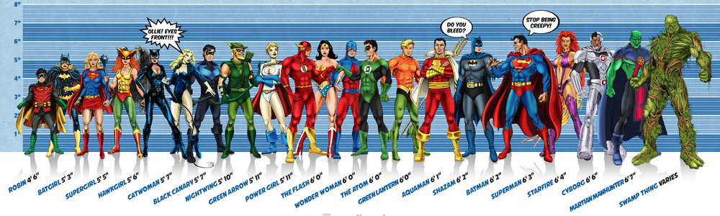
Running example: superheroes
Image credit: Ming Malaykham

Slide 5
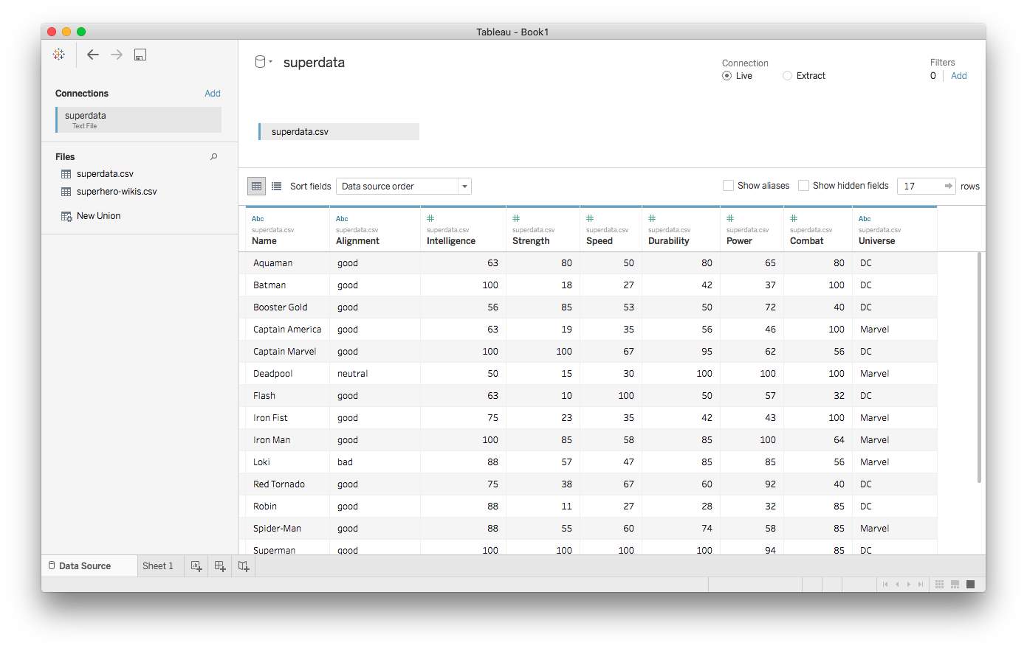
First dataset: superdata.csv

Slide 6
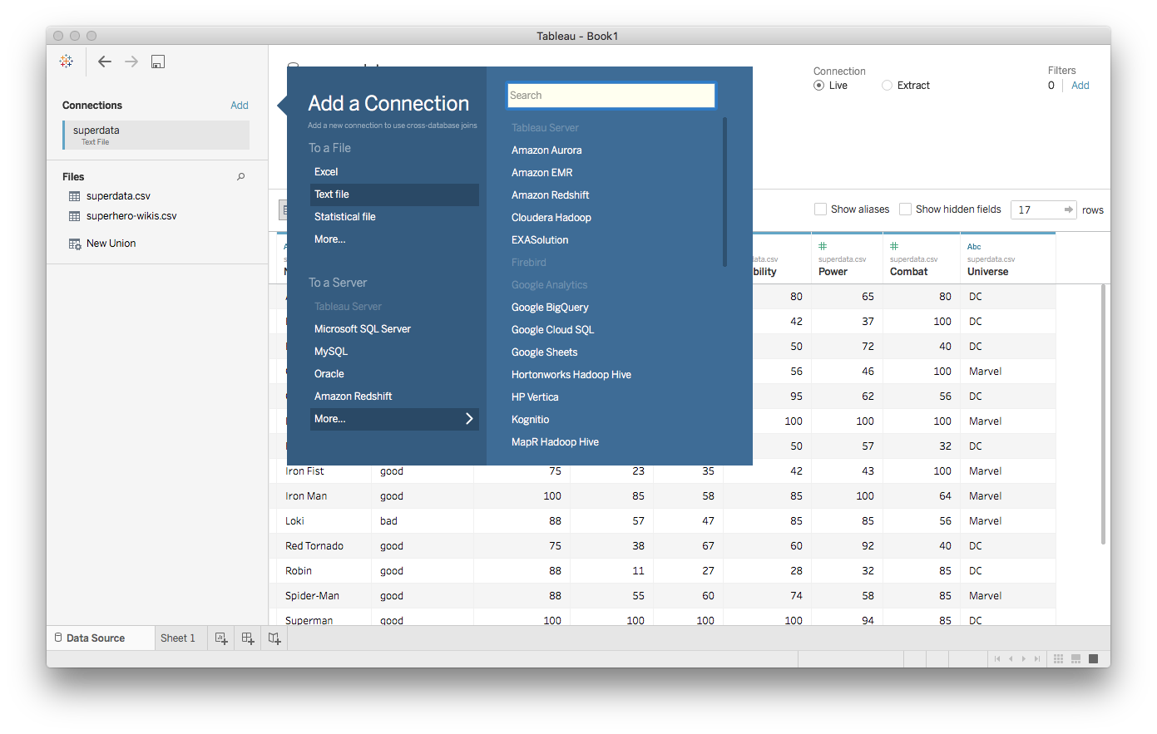
Adding more datasets

Slide 7
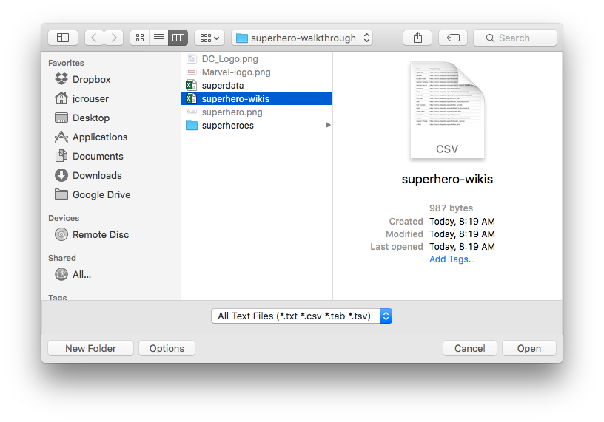
Adding more datasets

Slide 8
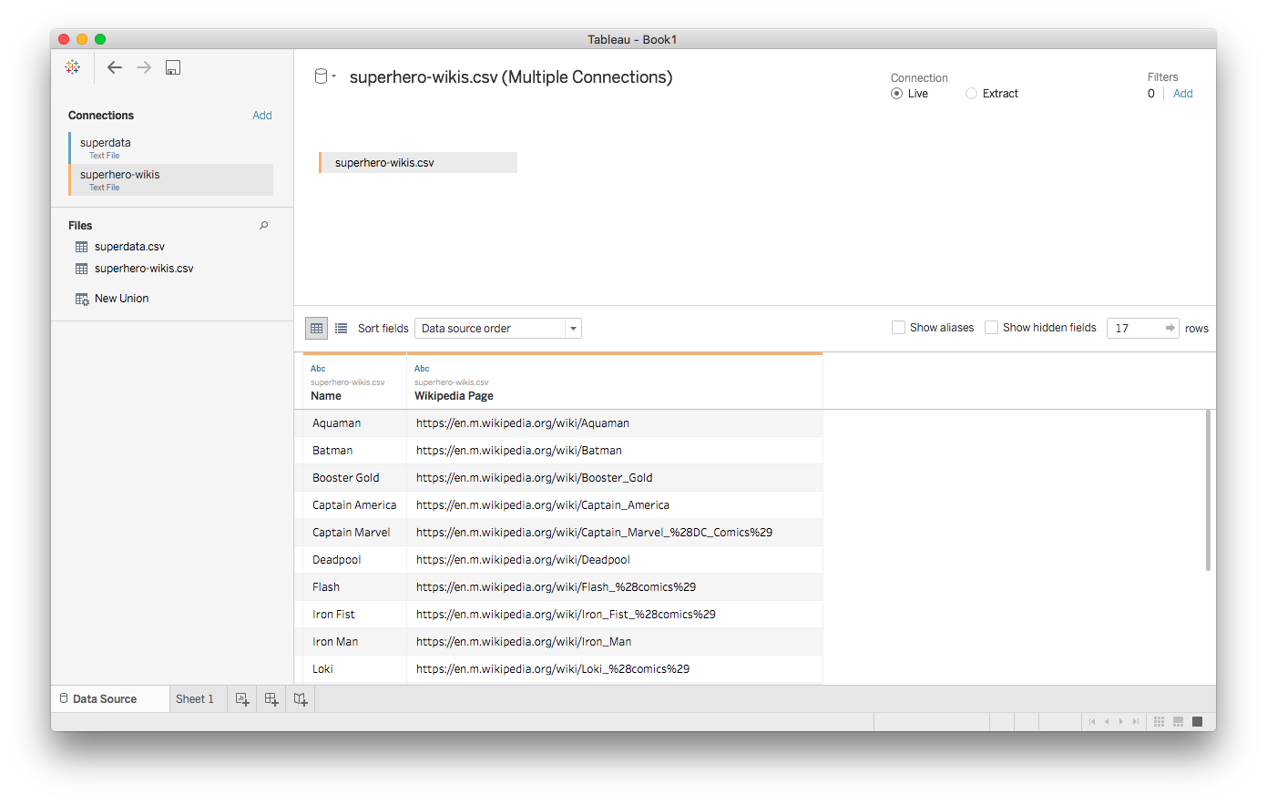
Second dataset: superhero-wikis.csv

Slide 9
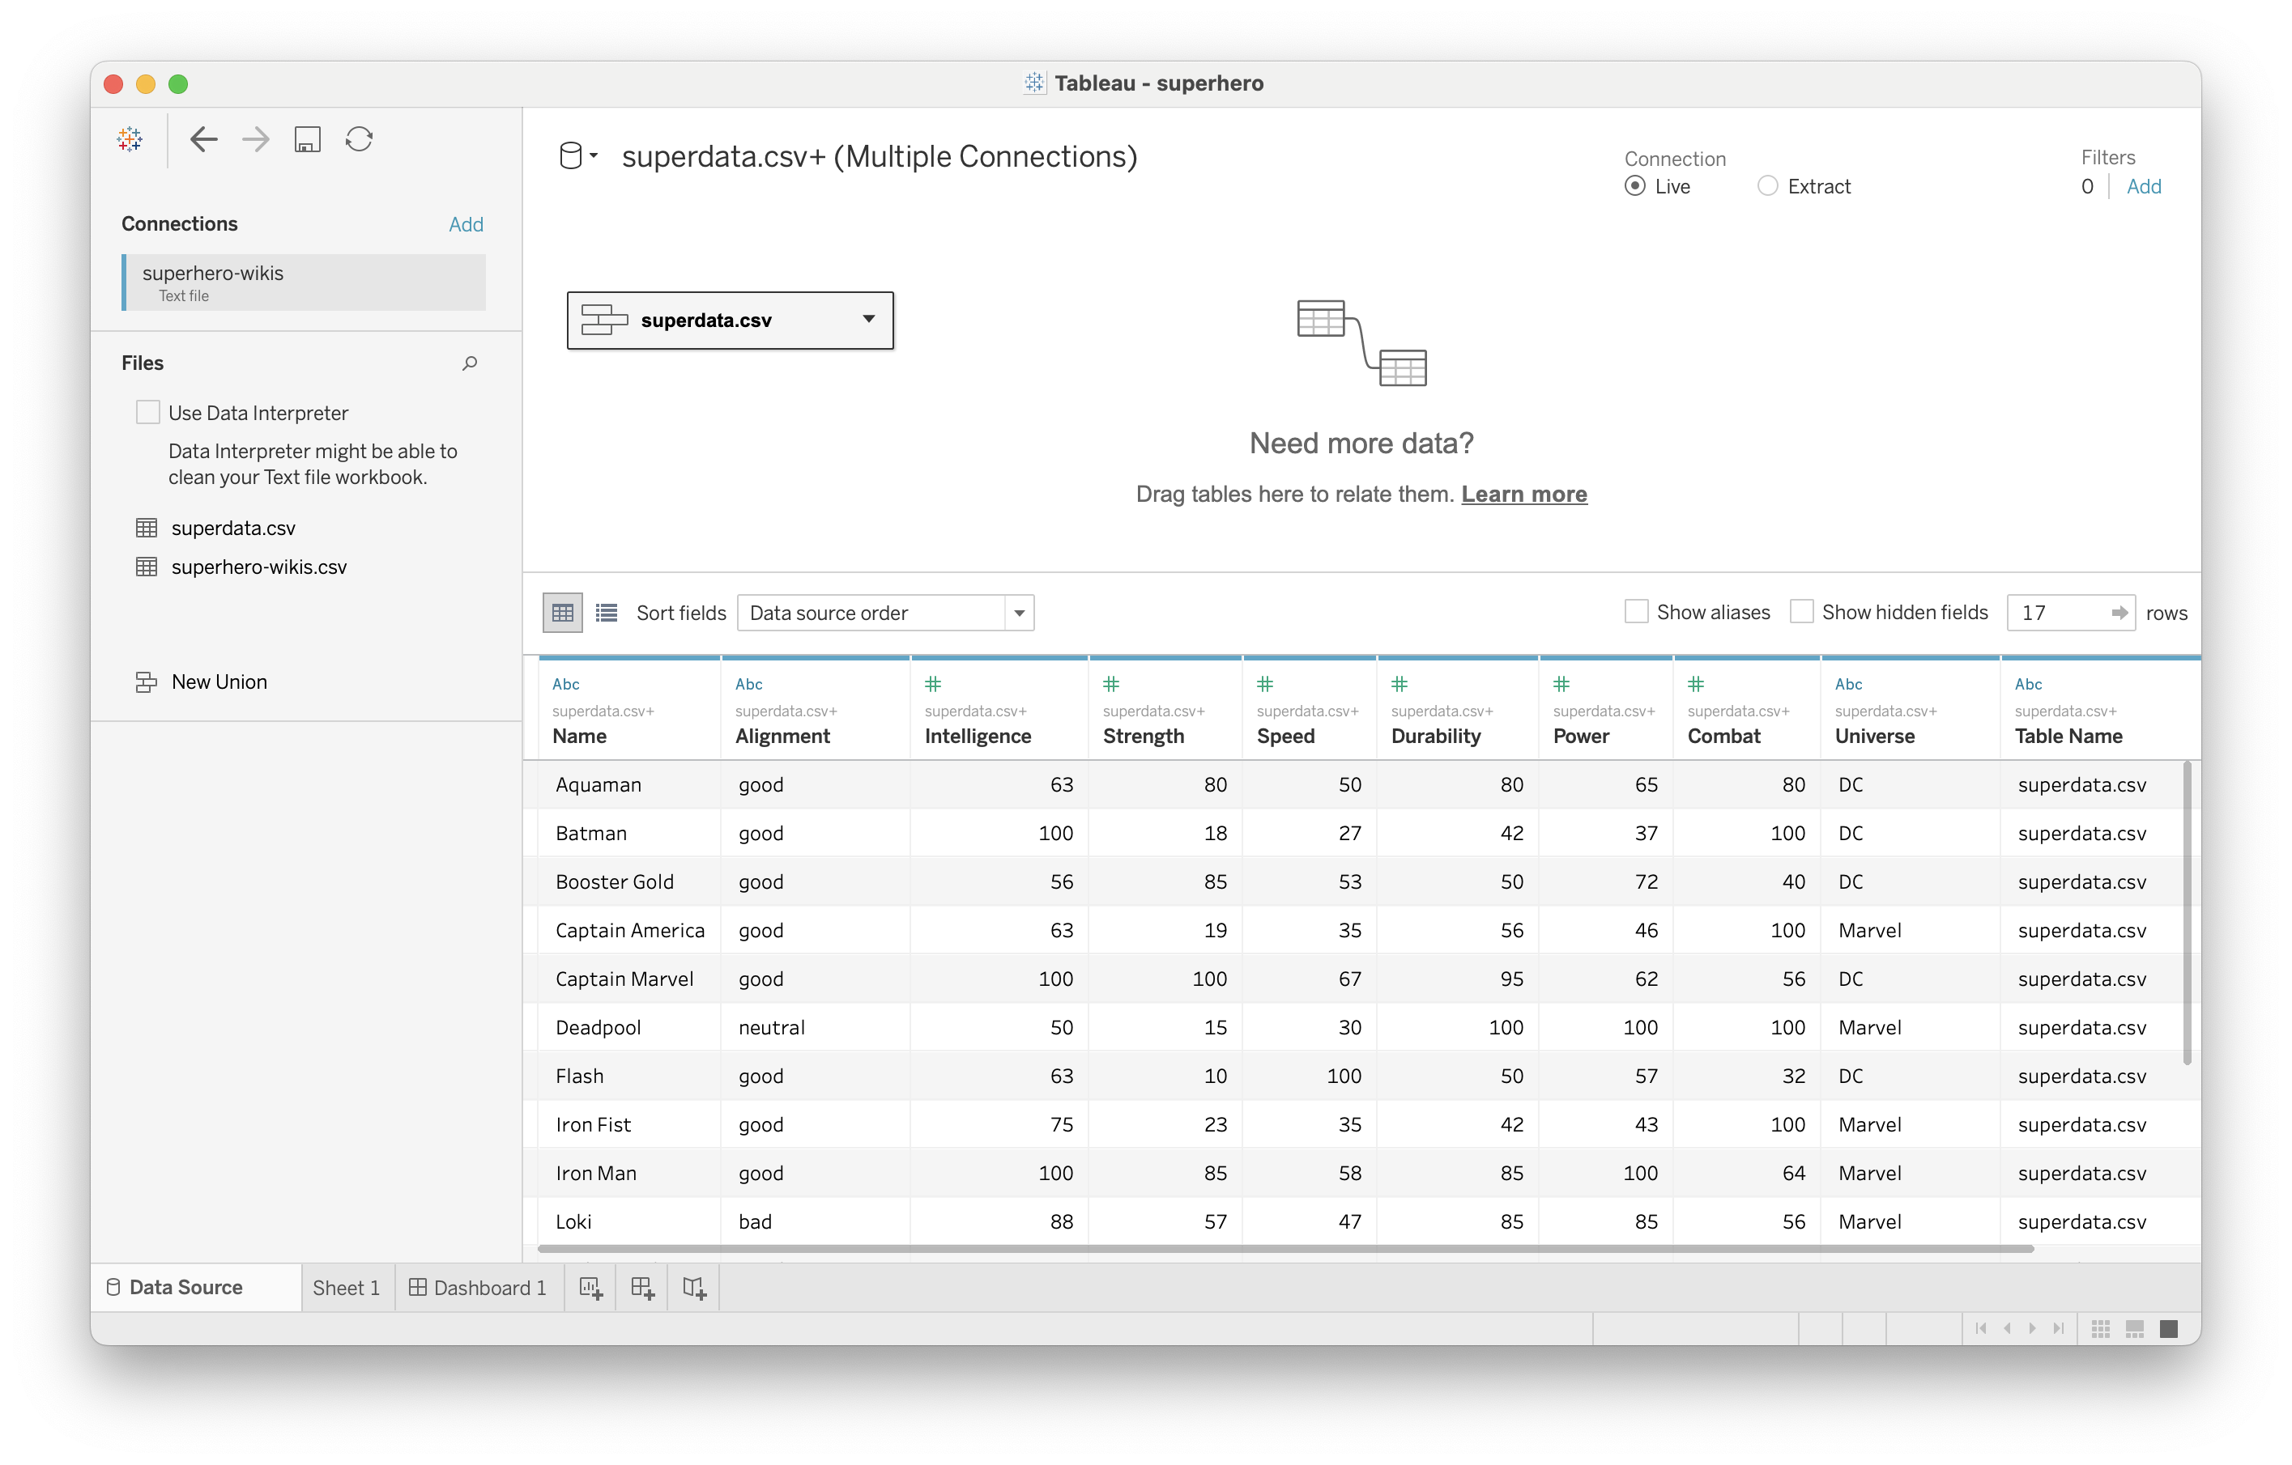
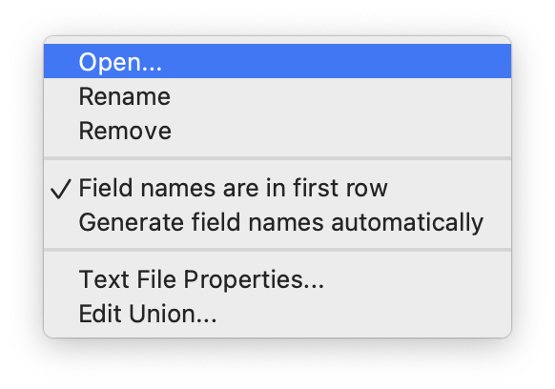
Joining the two
Notes:
Double click

Slide 10
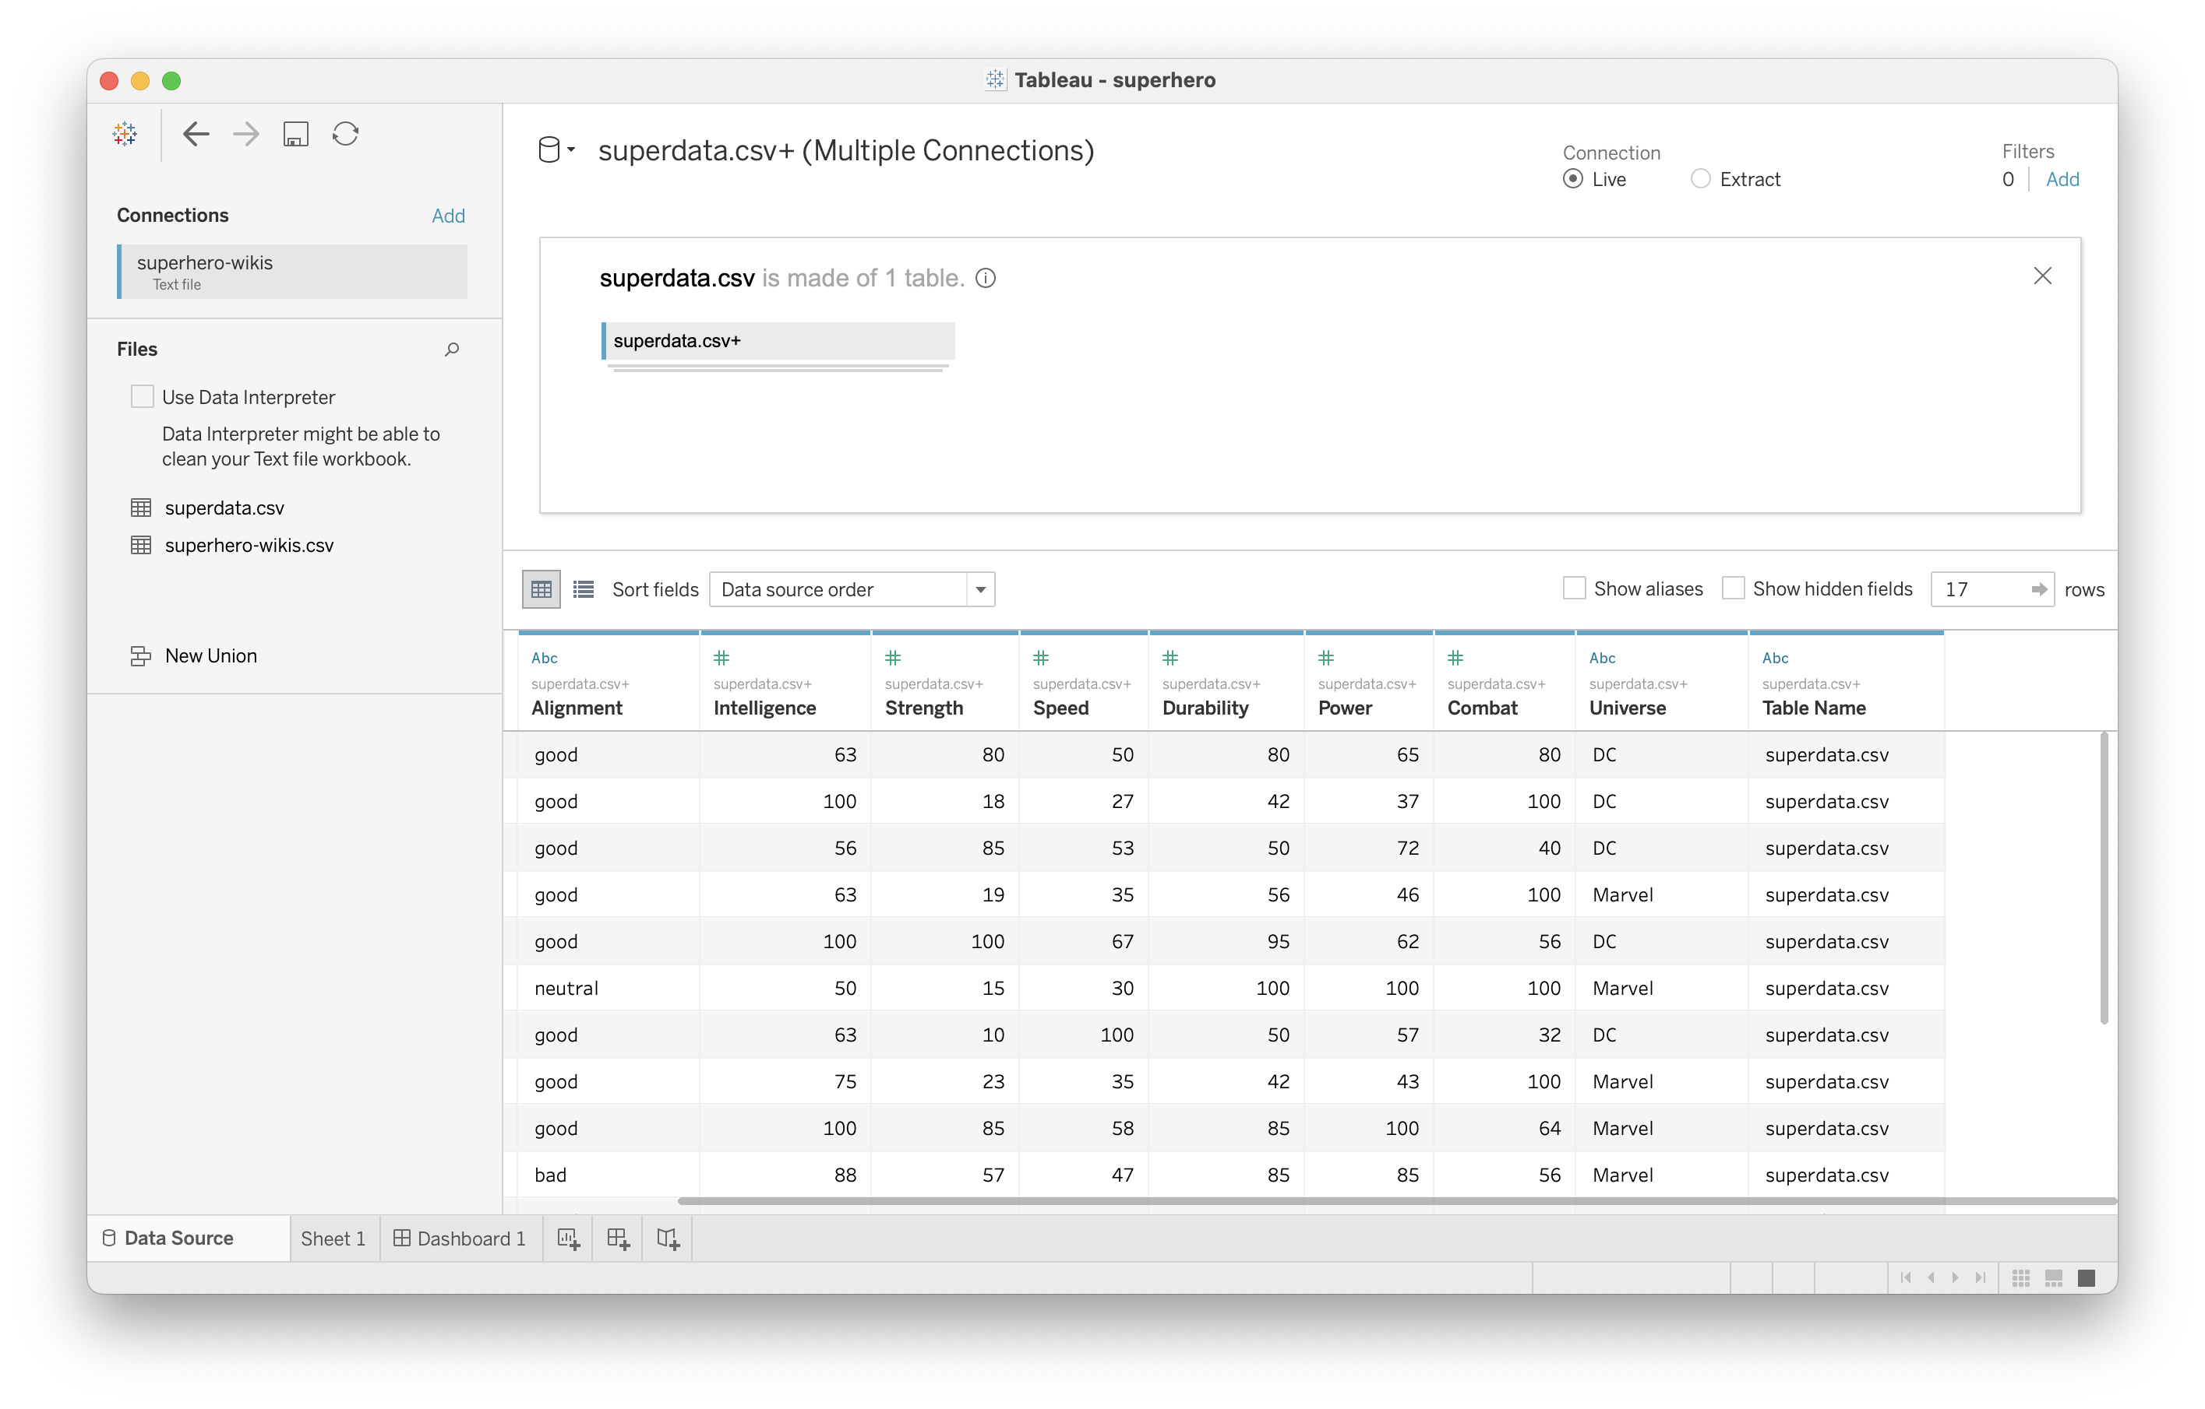
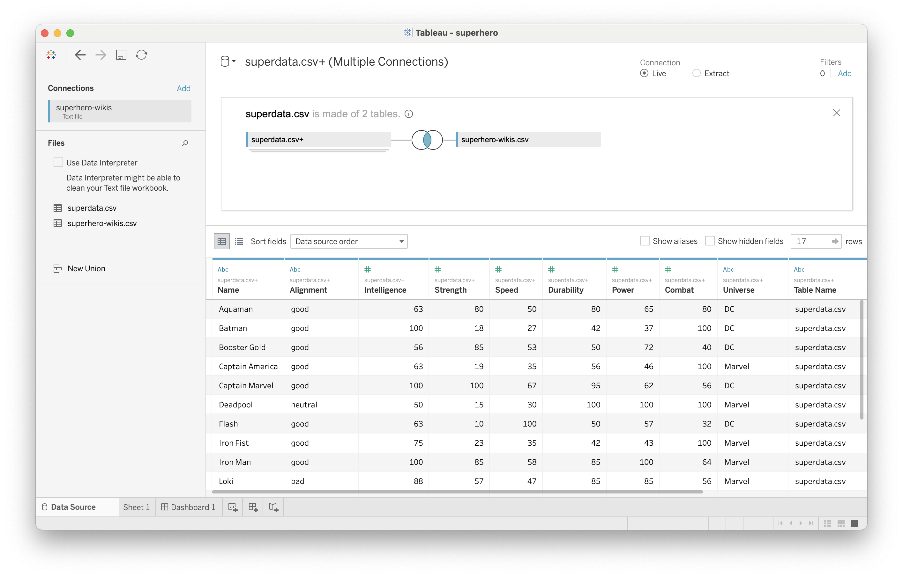
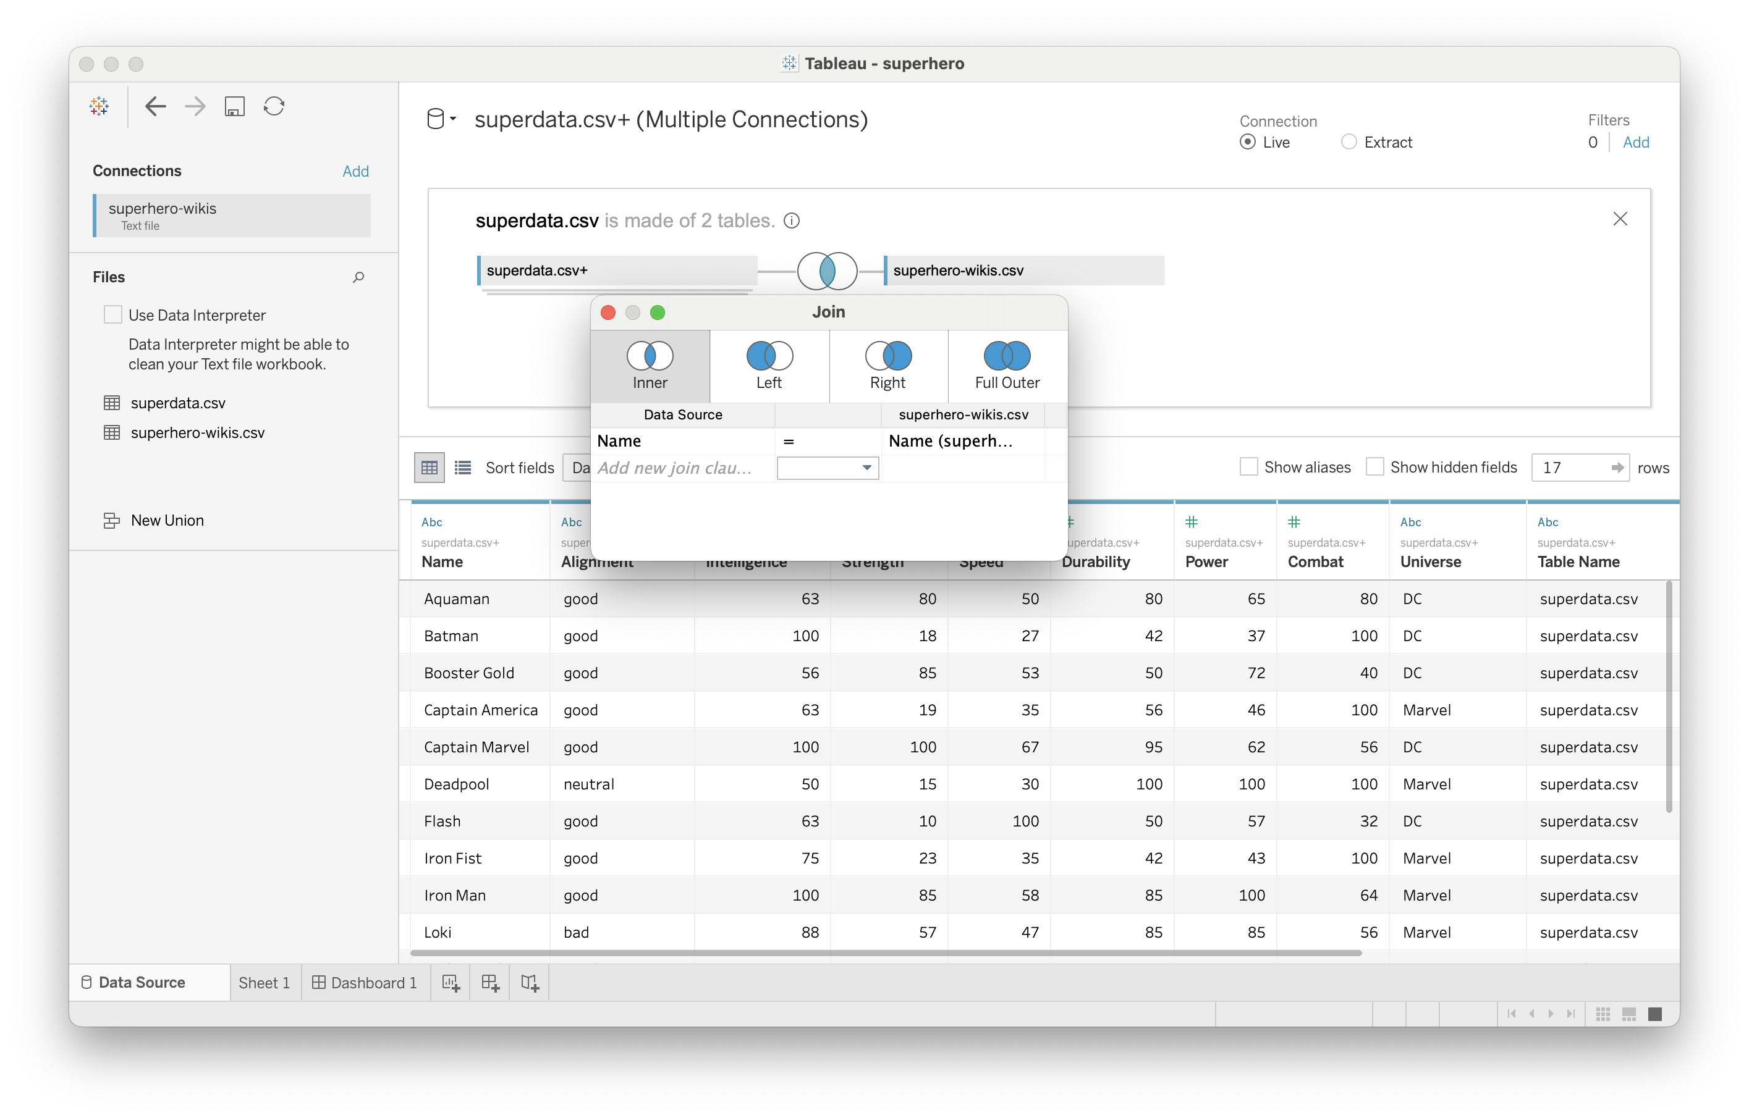
Joining the two
Notes:
Click here to edit relationship

Slide 11
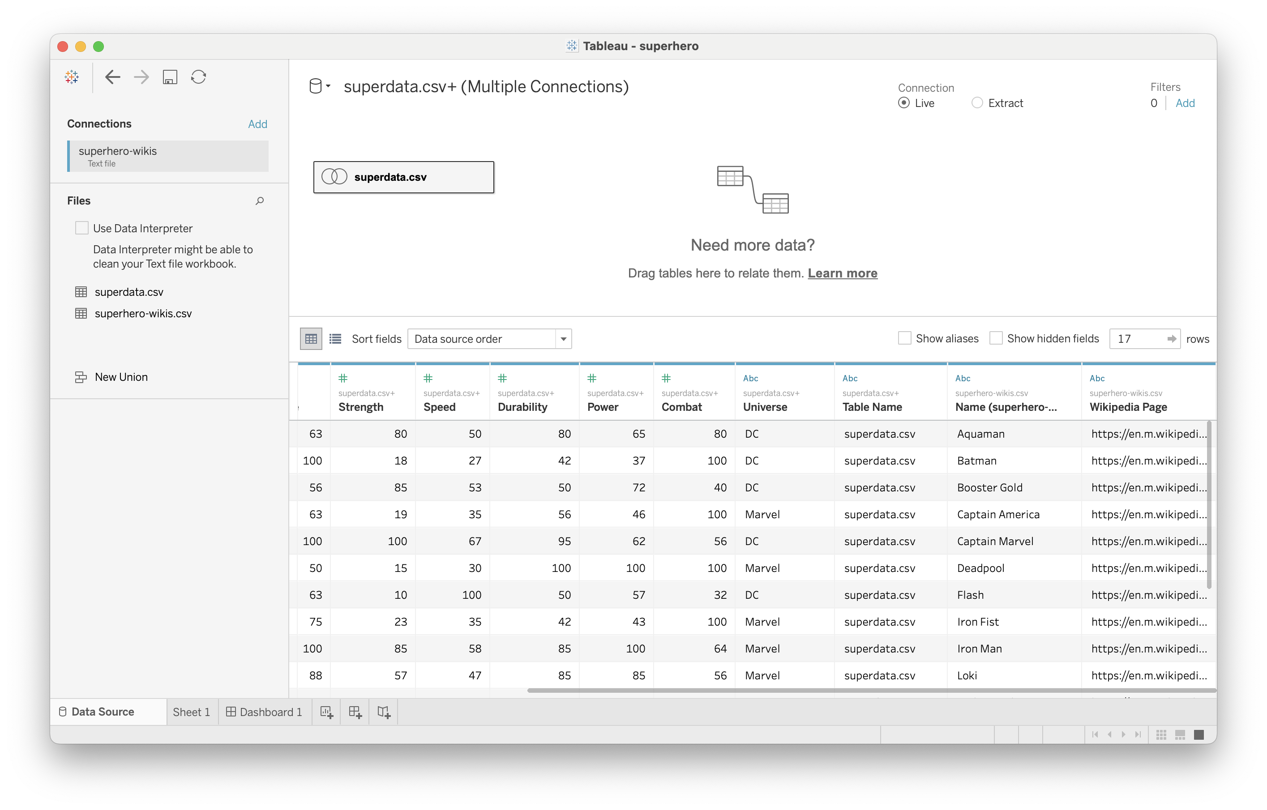
Joining the two
Notes:
Click here to edit relationship

Slide 12
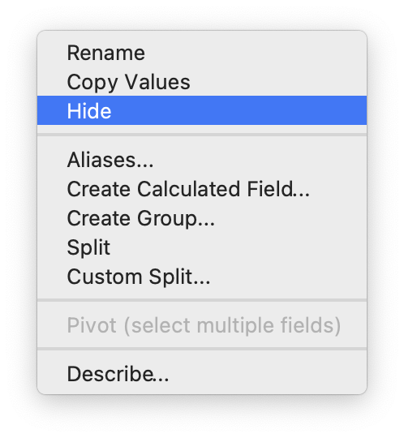
Hiding unnecessary data

Slide 13
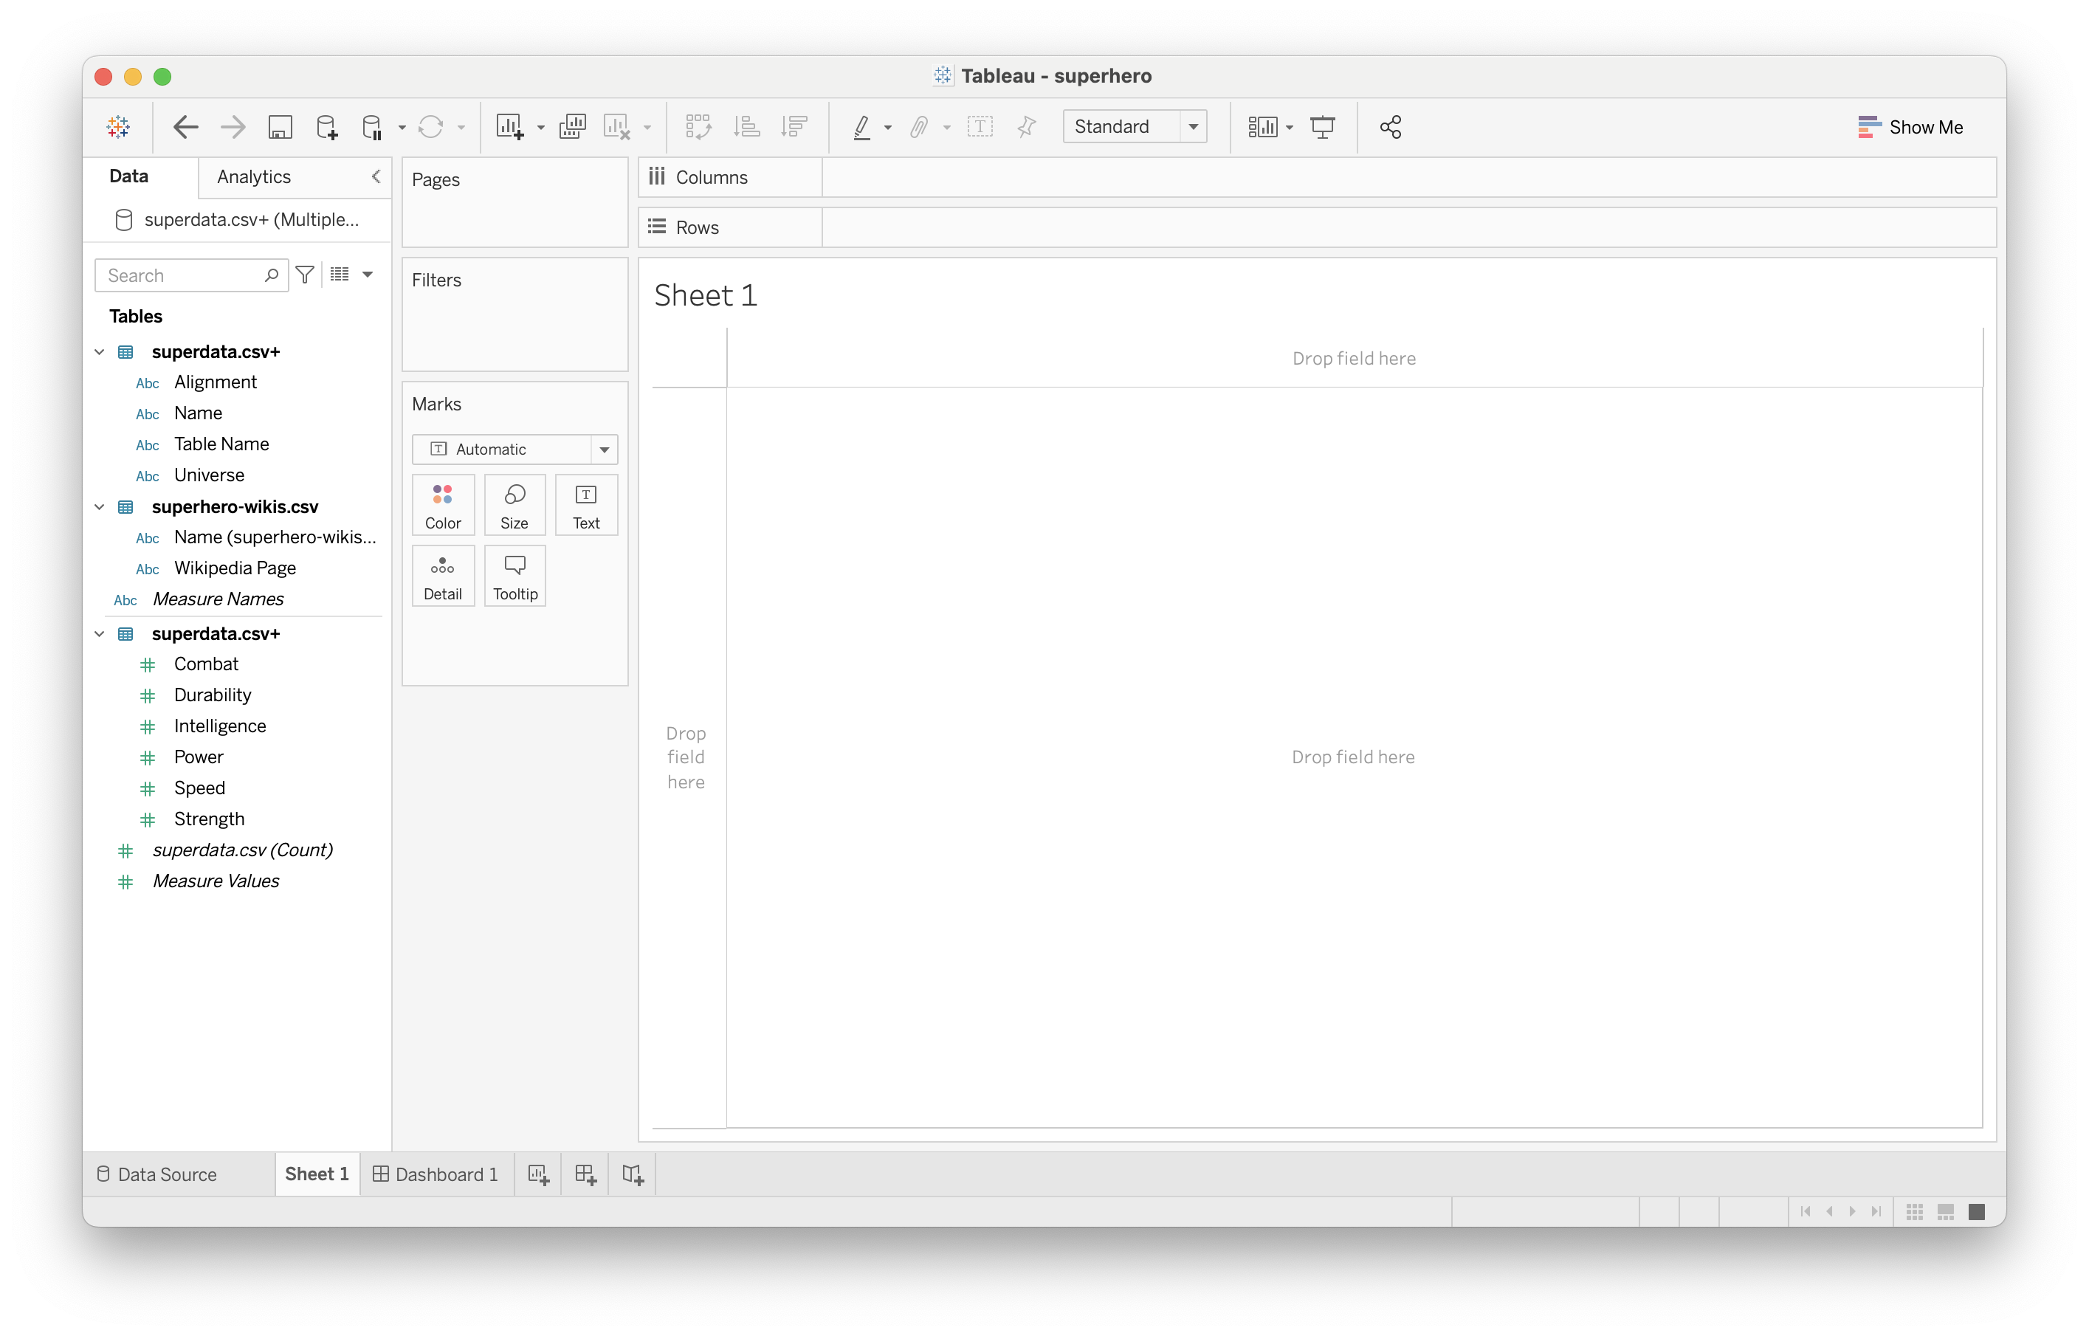
Over to Sheet1

Slide 14
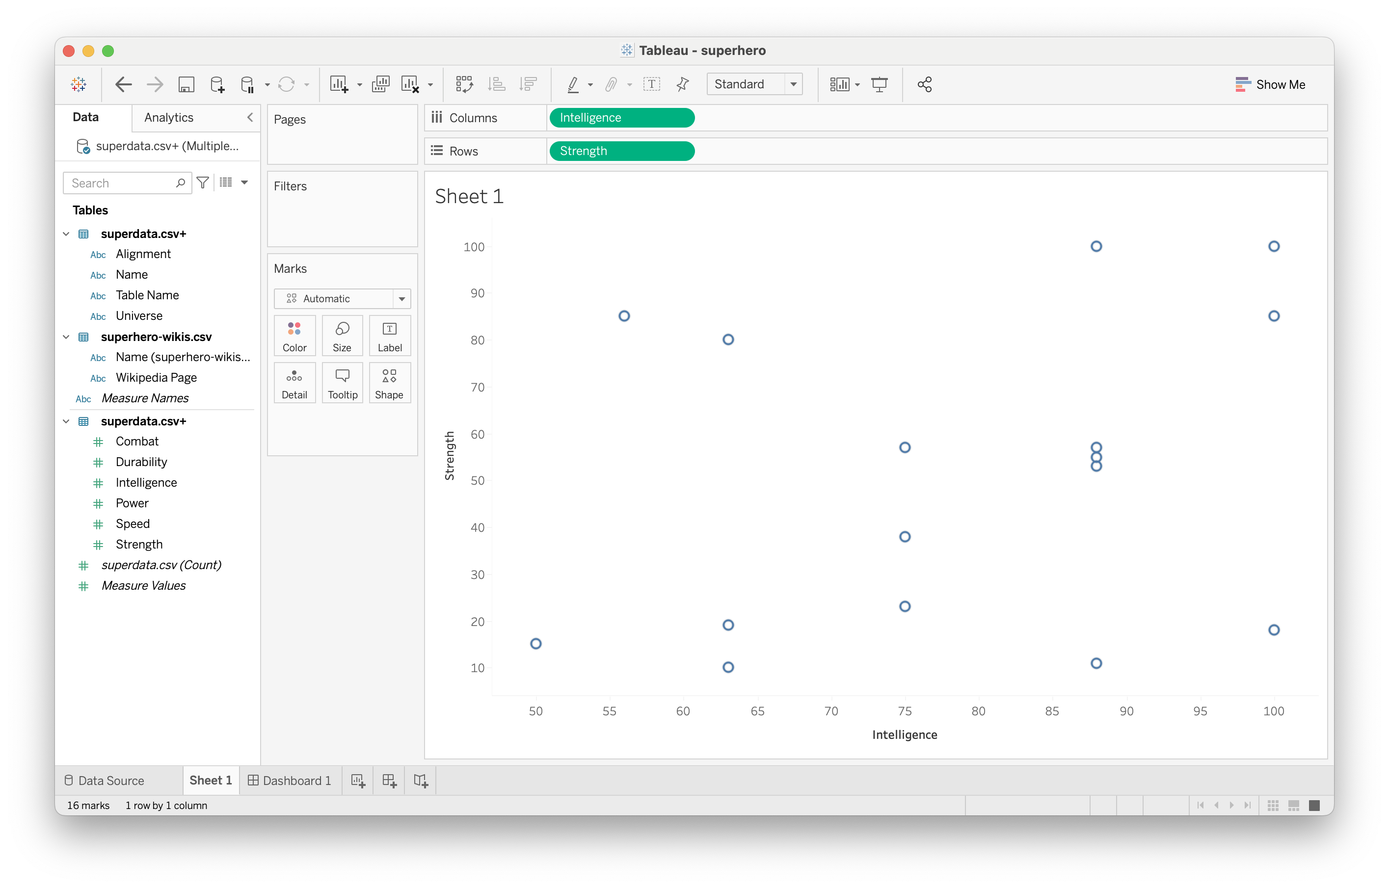
Simple scatterplot

Slide 15
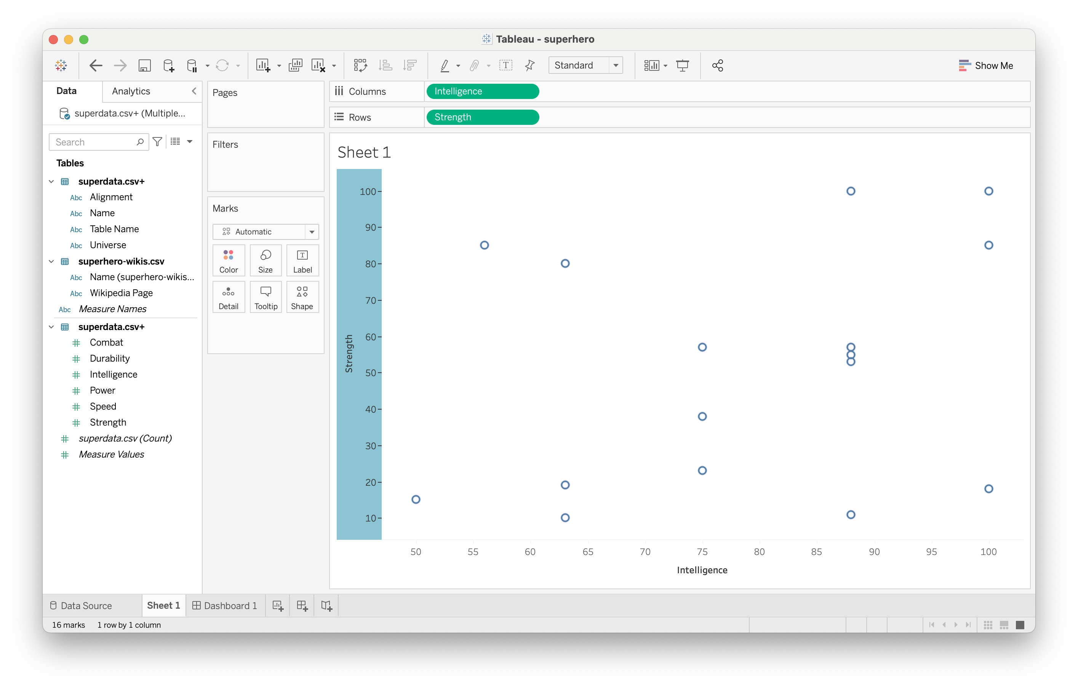
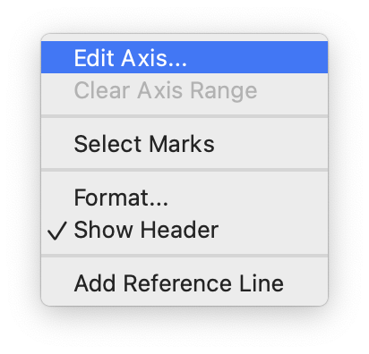
Editing axis values

Slide 16
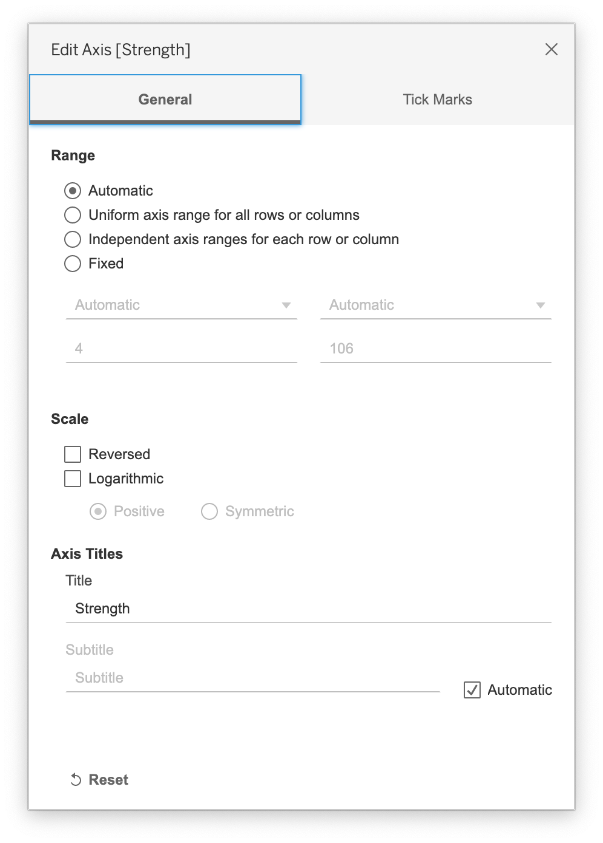
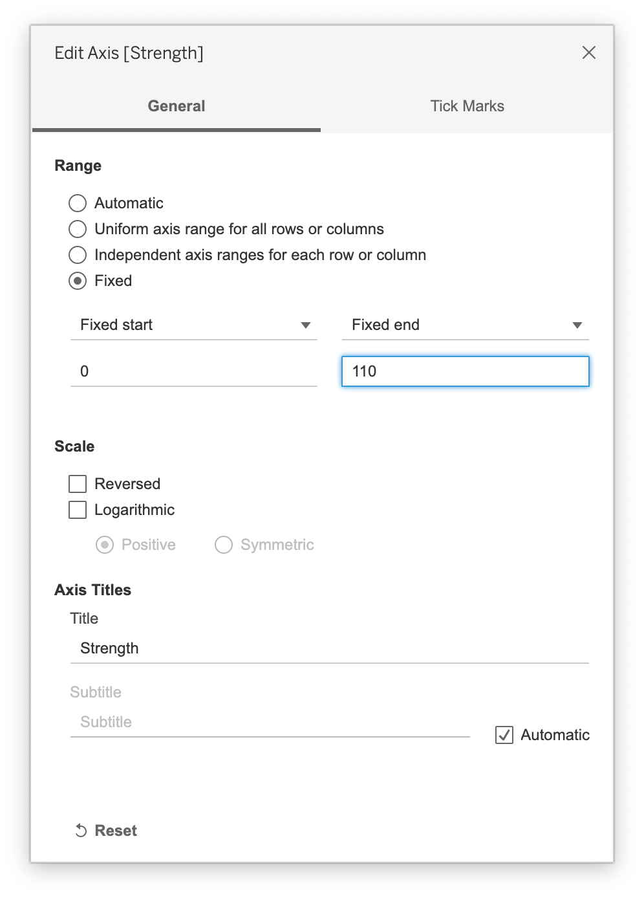
Editing axis values

Slide 17

Editing axis values

Slide 18
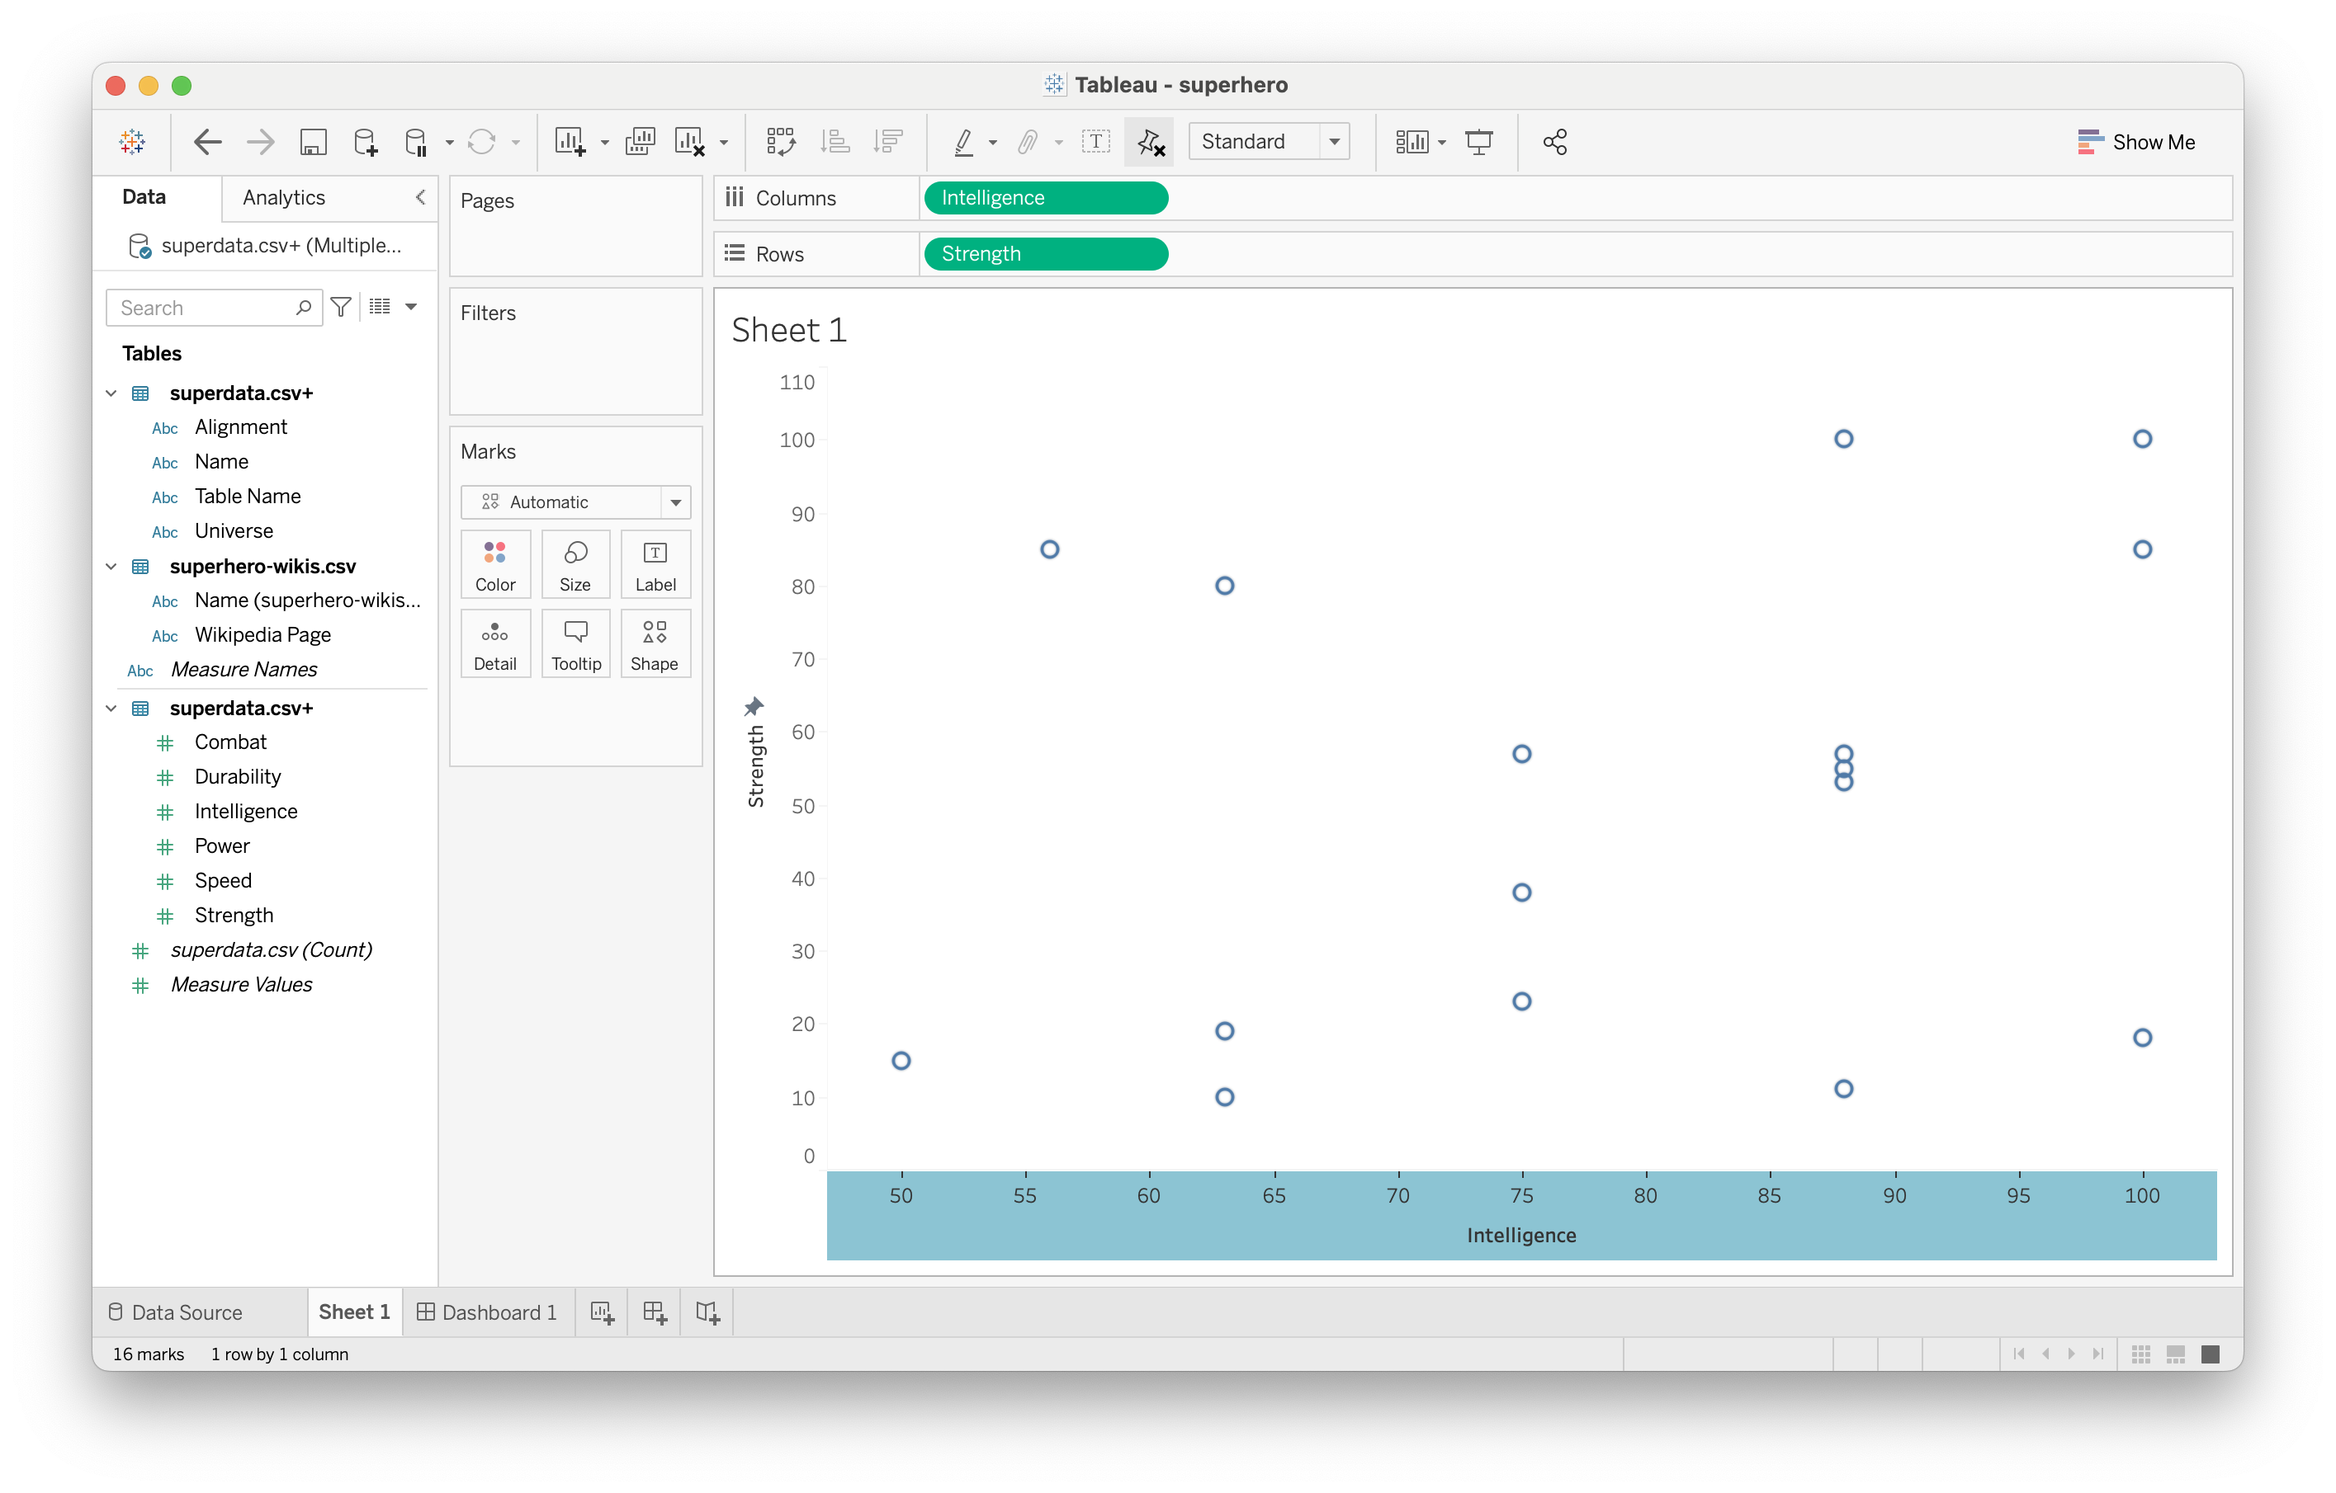
Editing axis values

Slide 19

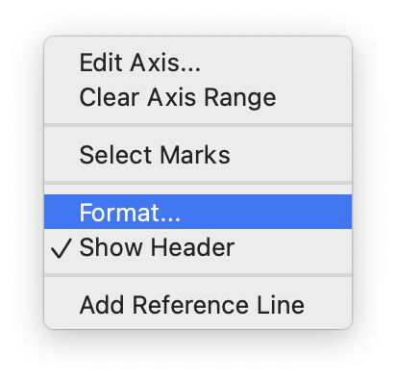
Format axis title

Slide 20
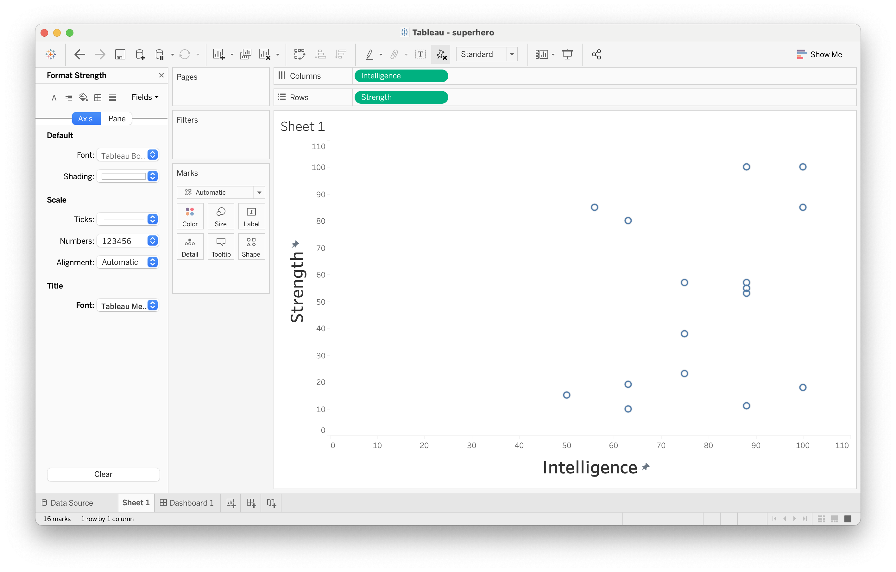
Format axis title

Slide 21

More interesting tooltips

Slide 22
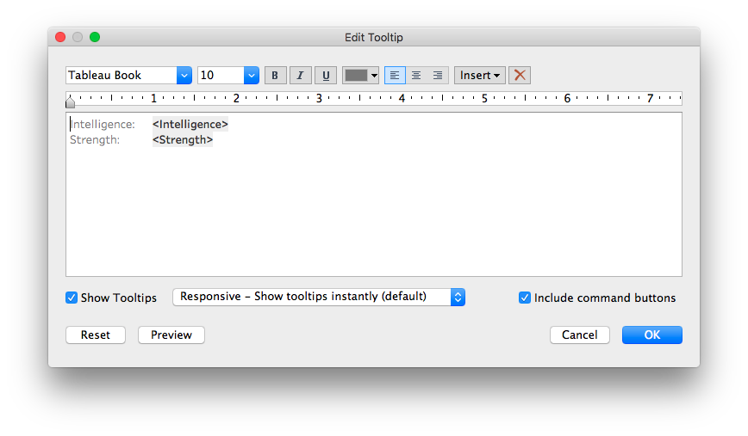
More interesting tooltips

Slide 23
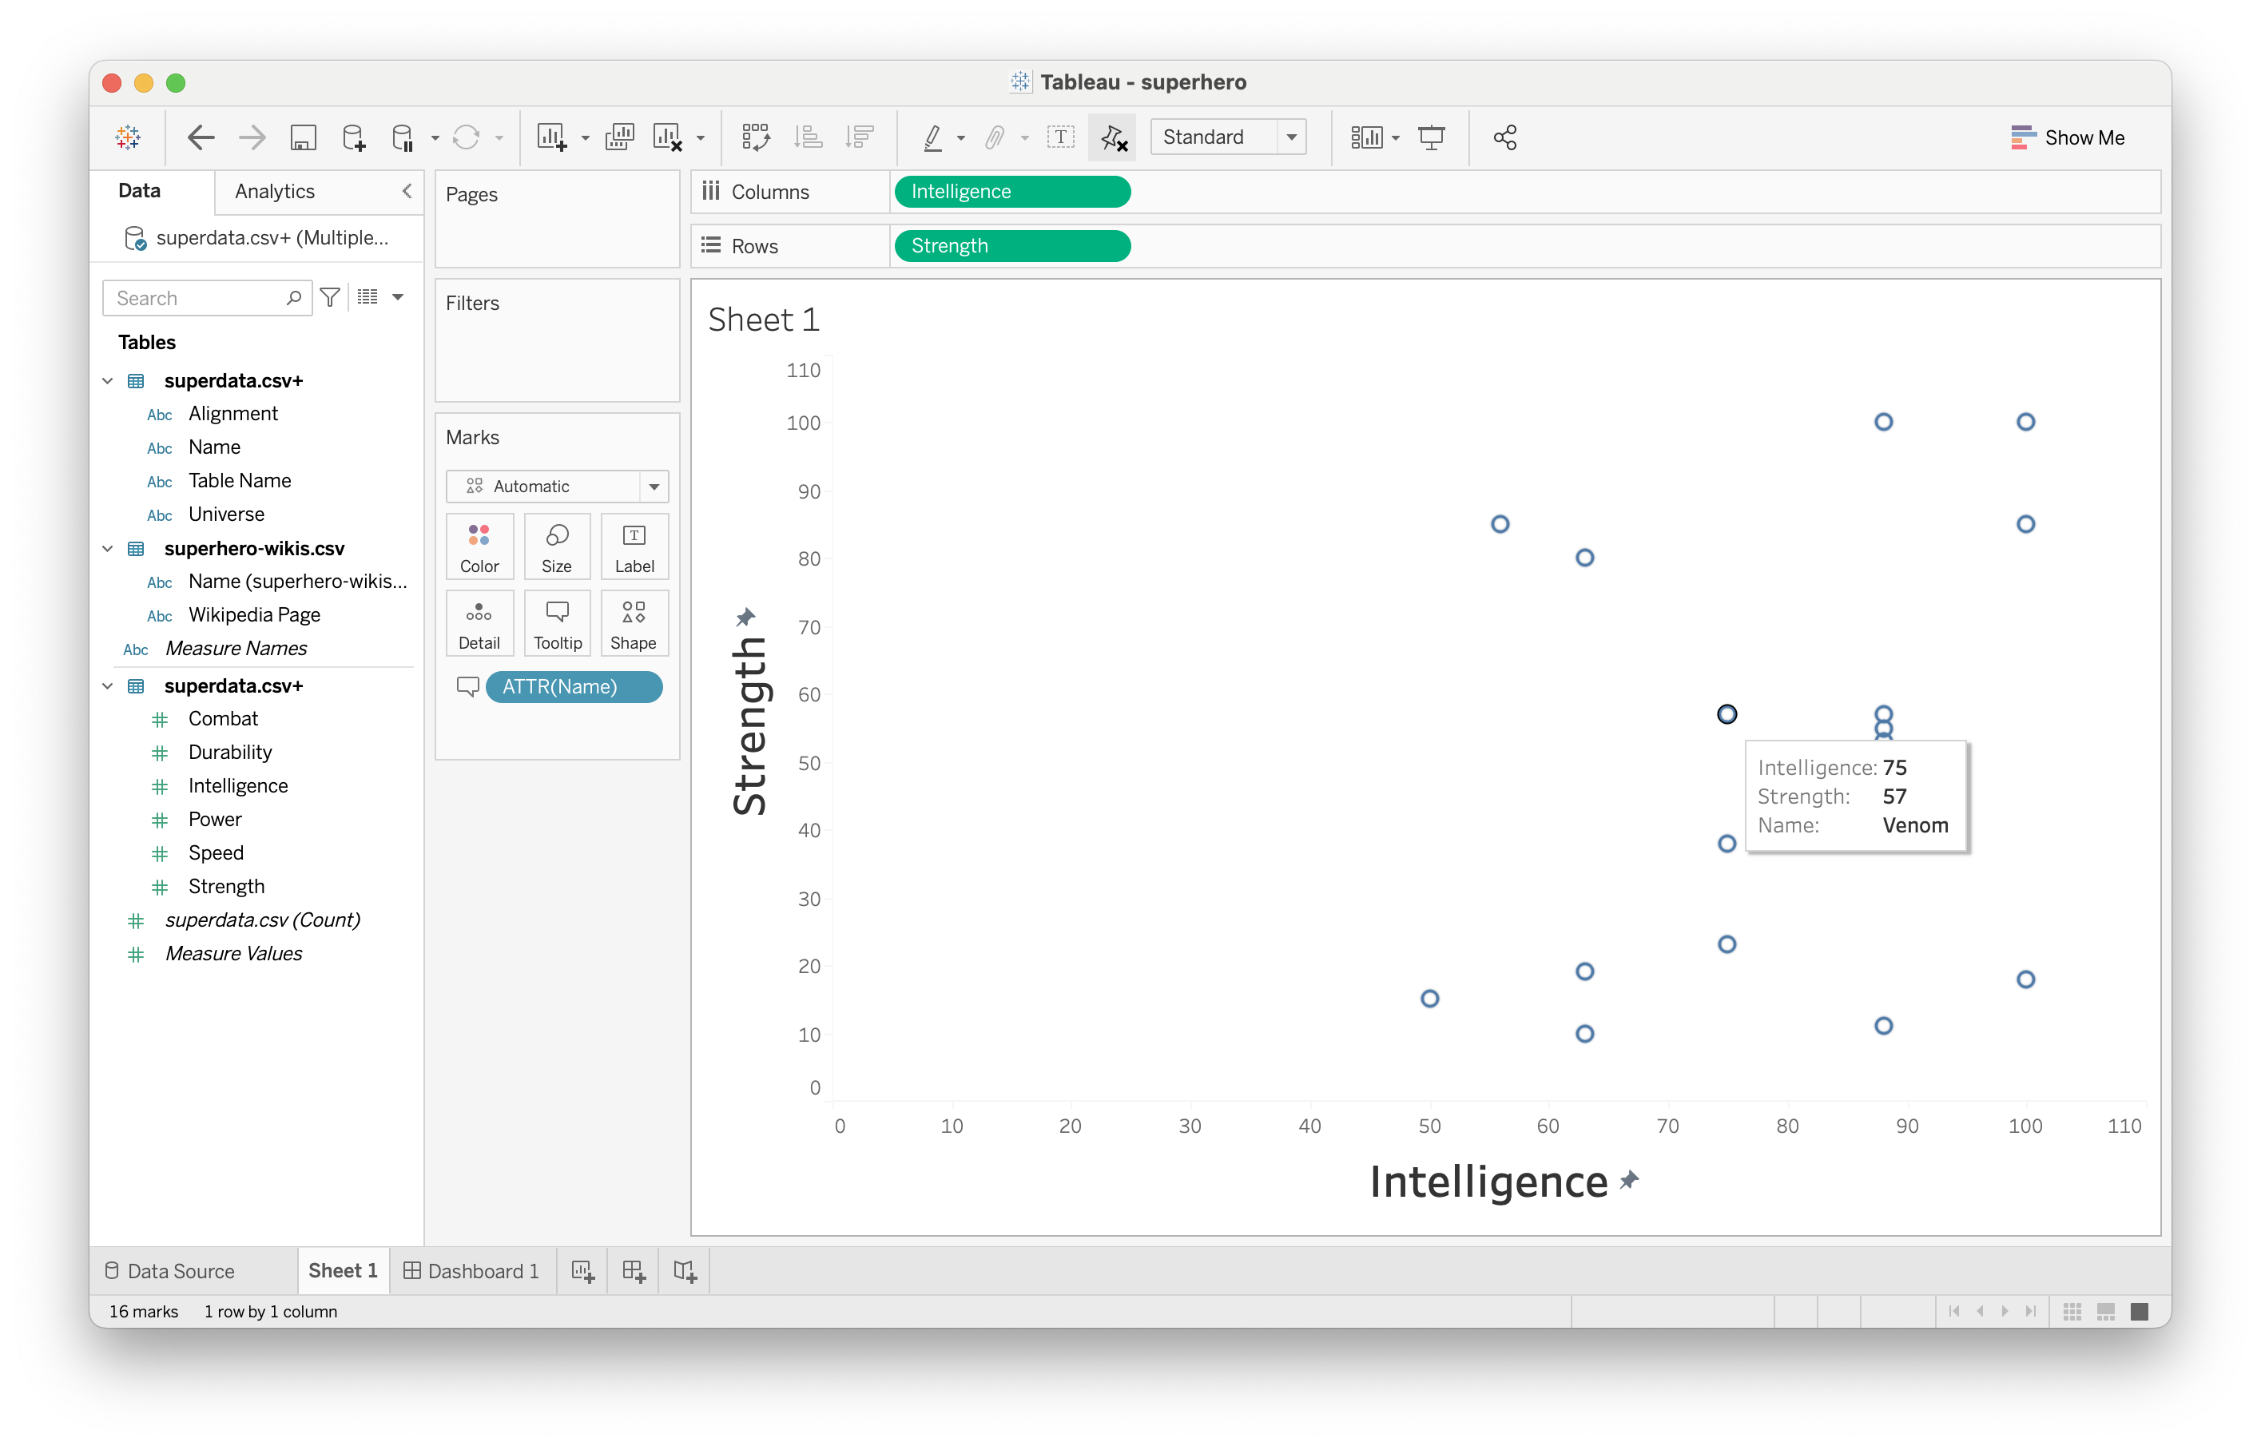
More interesting tooltips

Slide 24
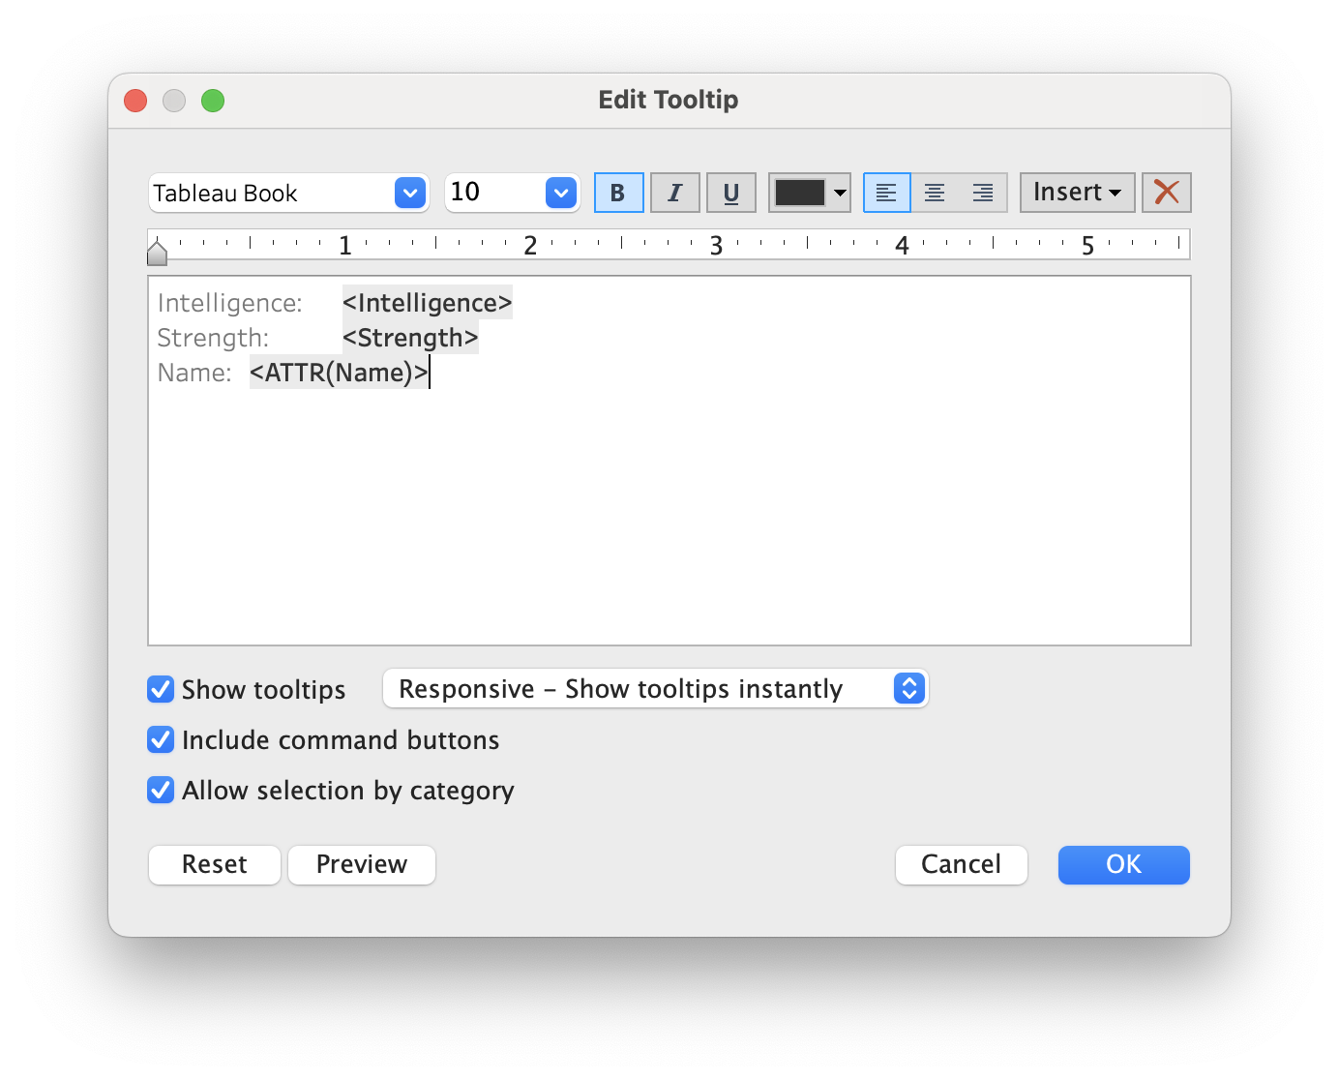
More interesting tooltips

Slide 25
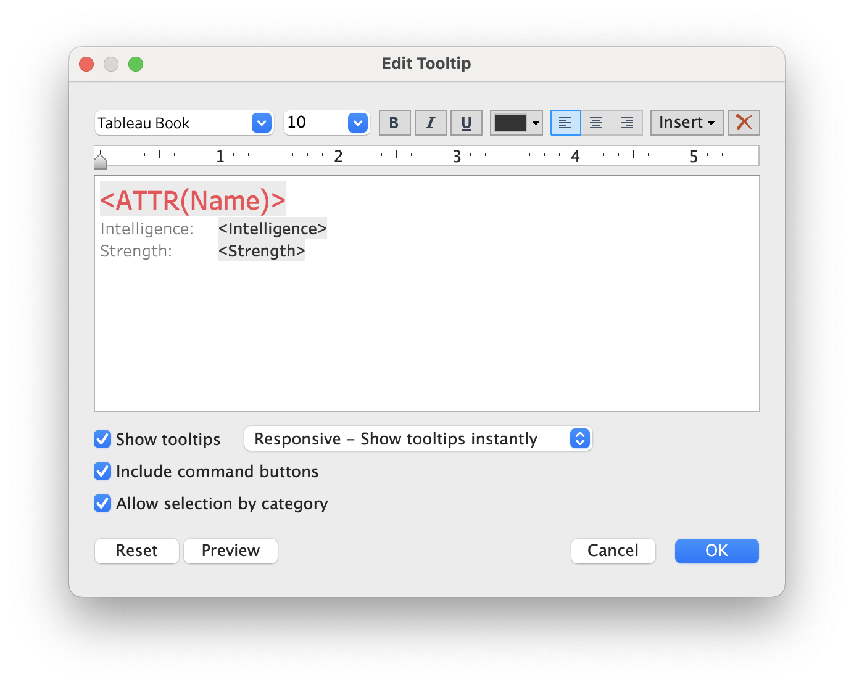
More interesting tooltips

Slide 26

More interesting tooltips

Slide 27
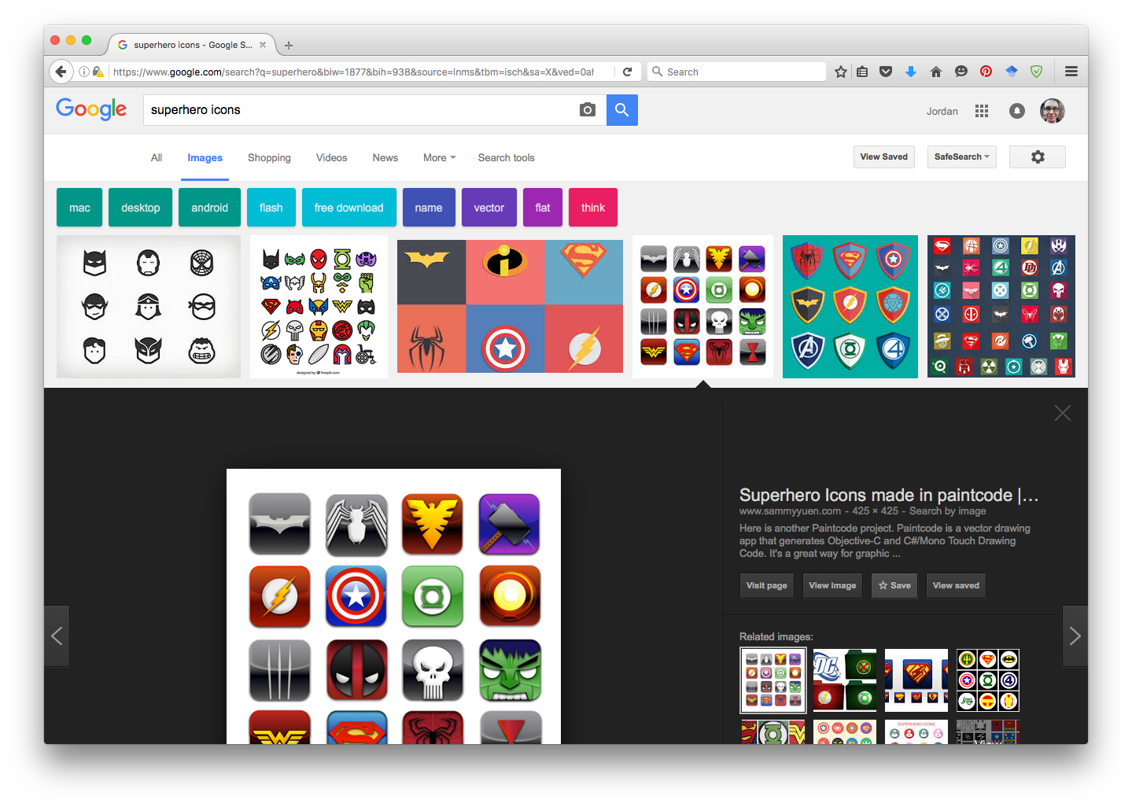
Adding custom shapes

Slide 28
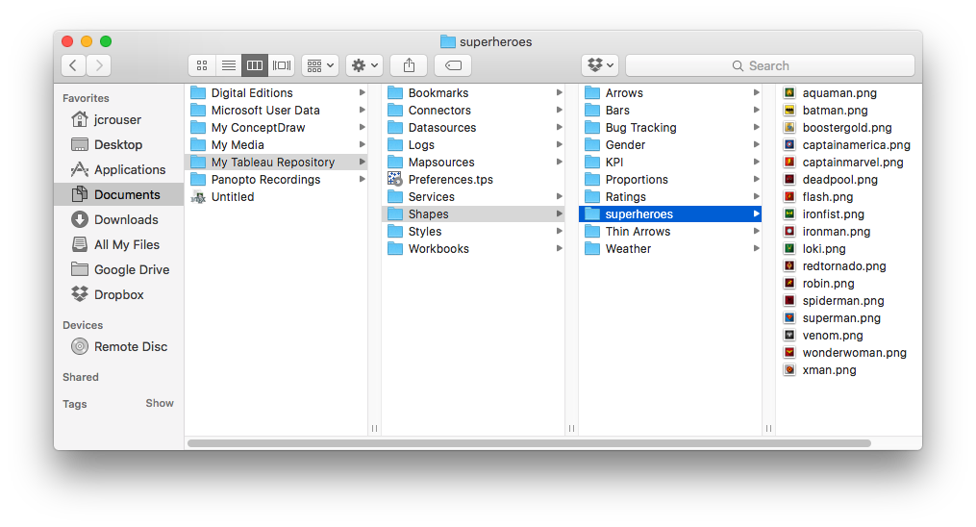
Adding custom shapes

Slide 29
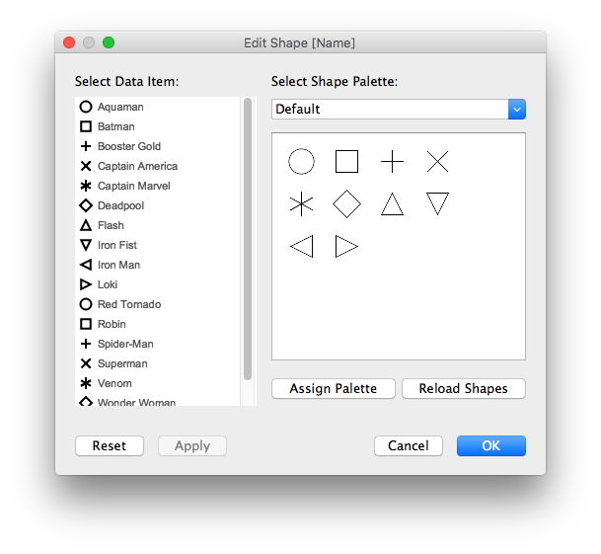
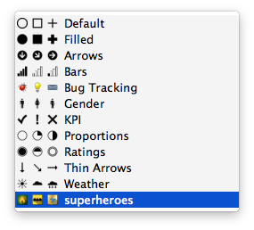
Adding custom shapes

Slide 30
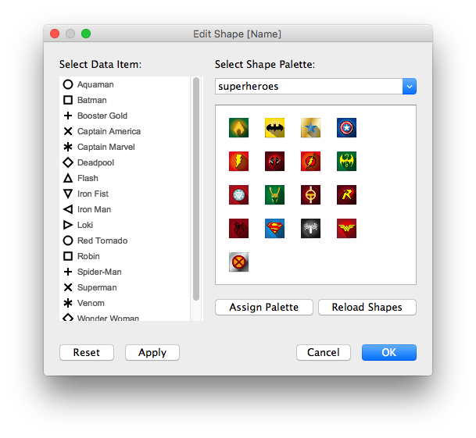
Adding custom shapes

Slide 31
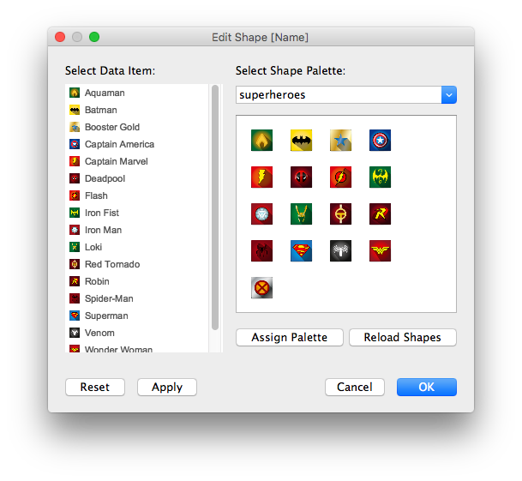
Adding custom shapes

Slide 32
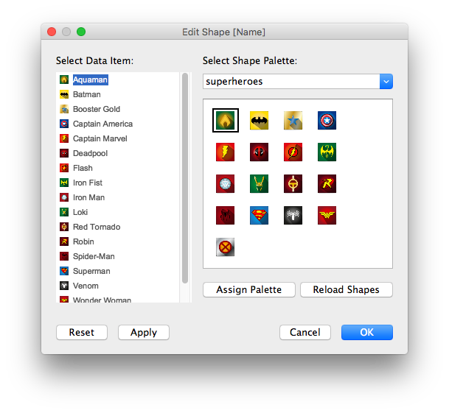
Adding custom shapes

Slide 33
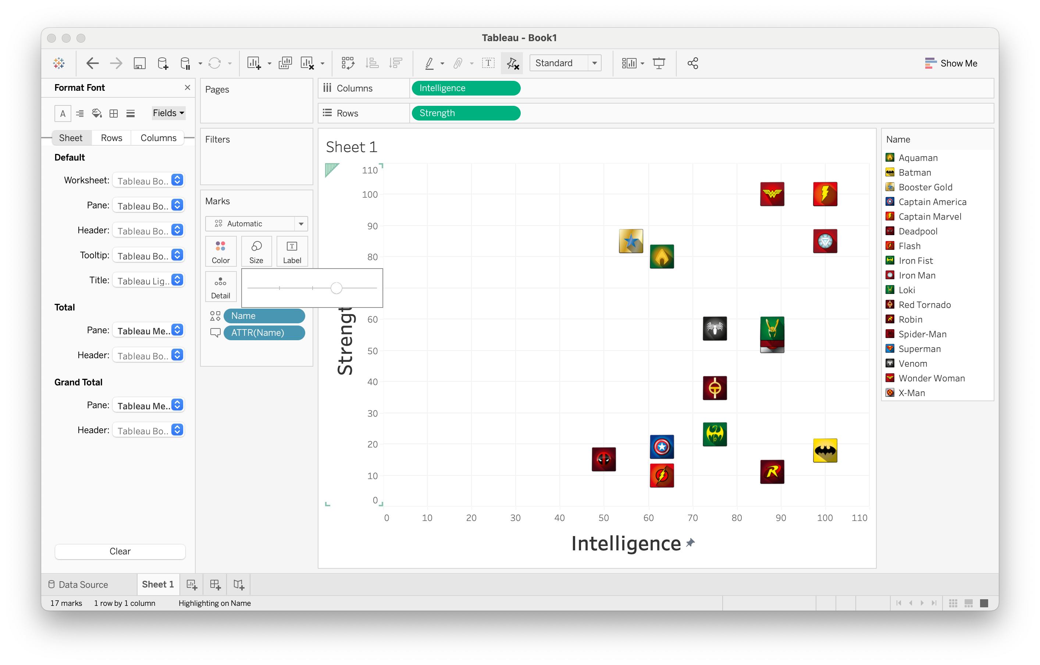
Scatterplot with custom shapes

Slide 34
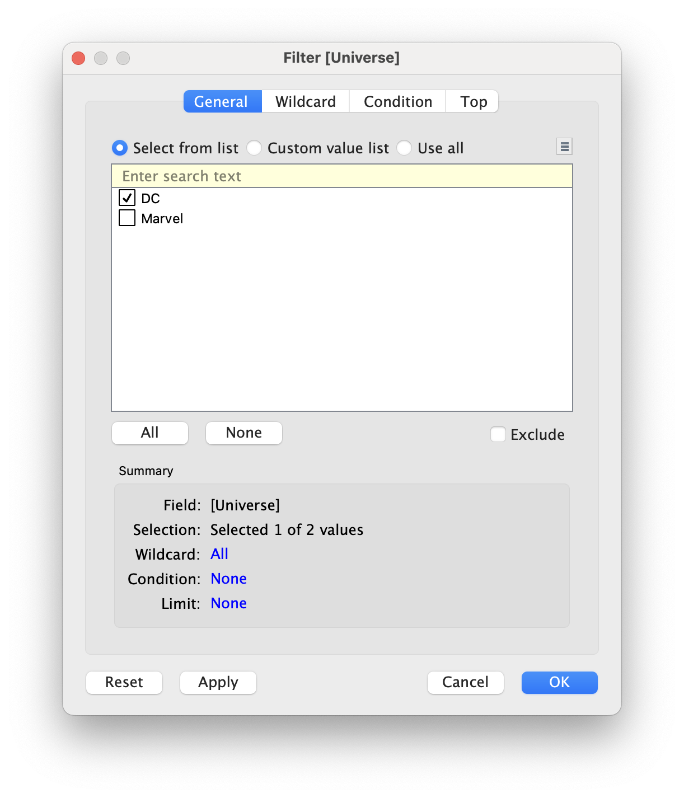
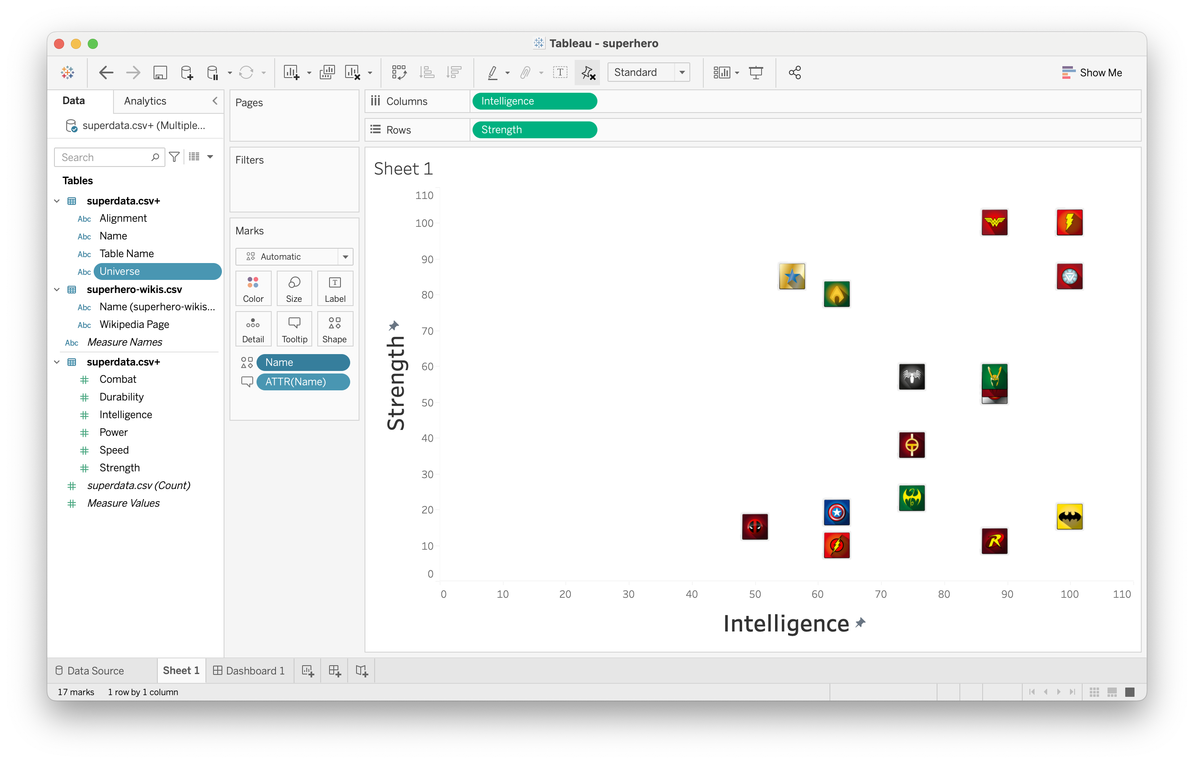
Working with filters

Slide 35
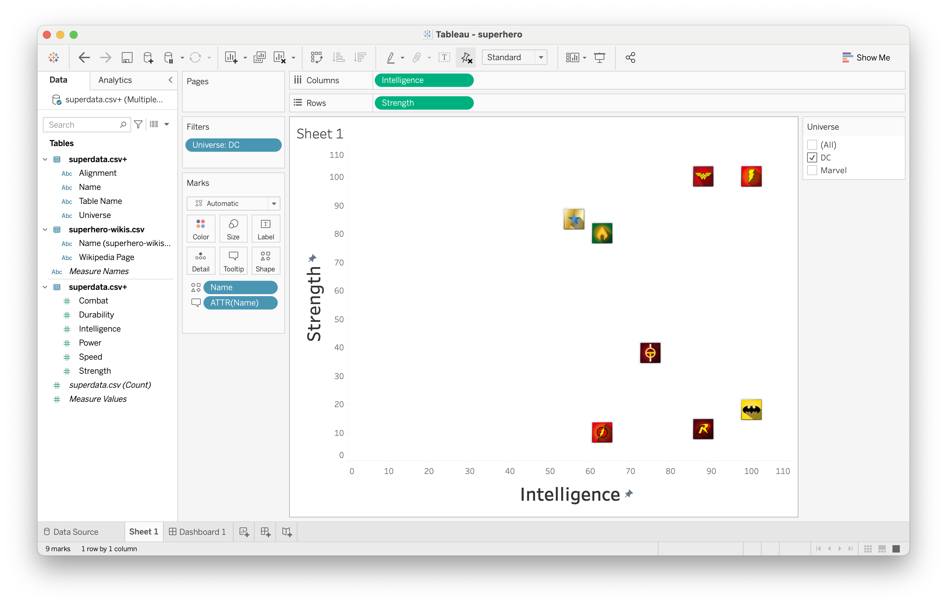
Working with filters

Slide 36
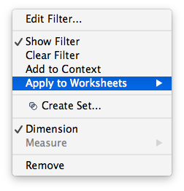
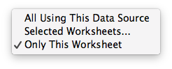
Changing a filter’s scope

Slide 37
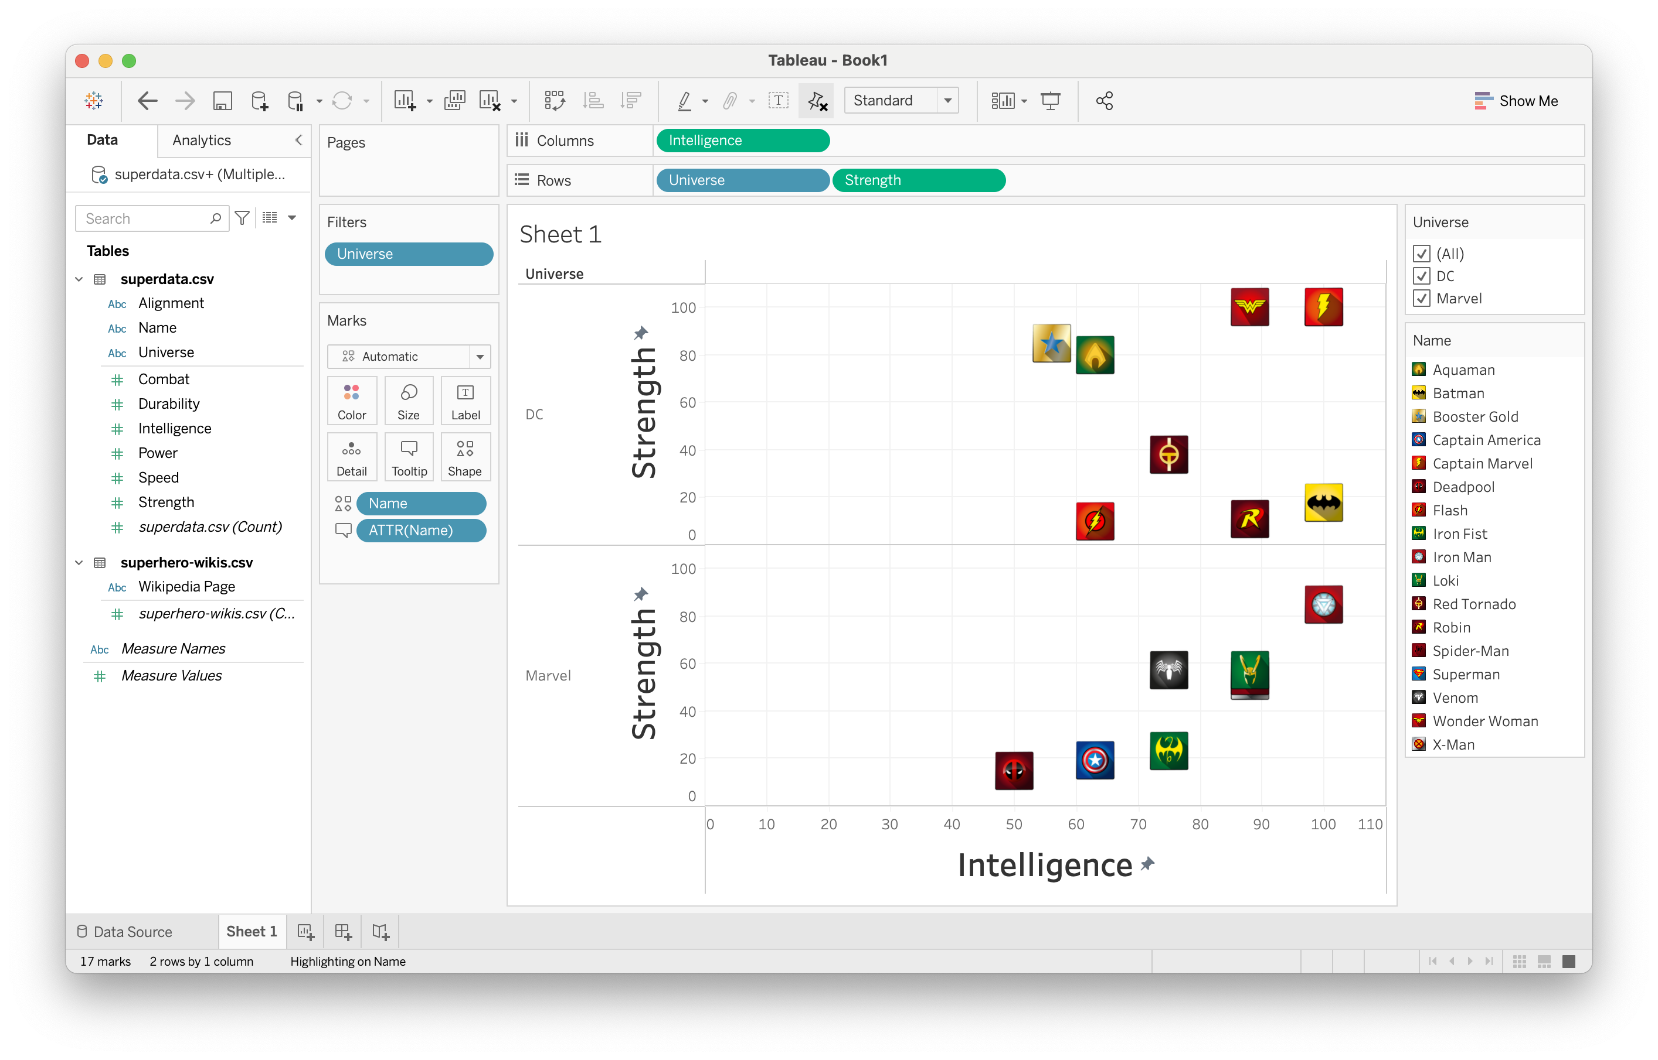
Implicit filtering (side-by-side comparison)

Slide 38


Adding background images

Slide 39
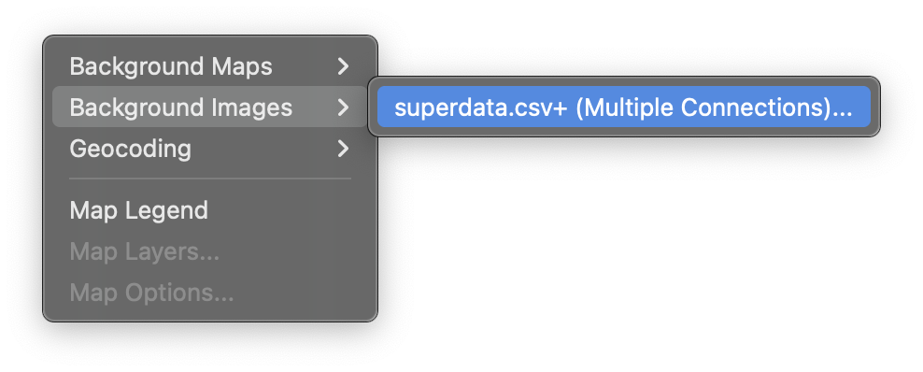
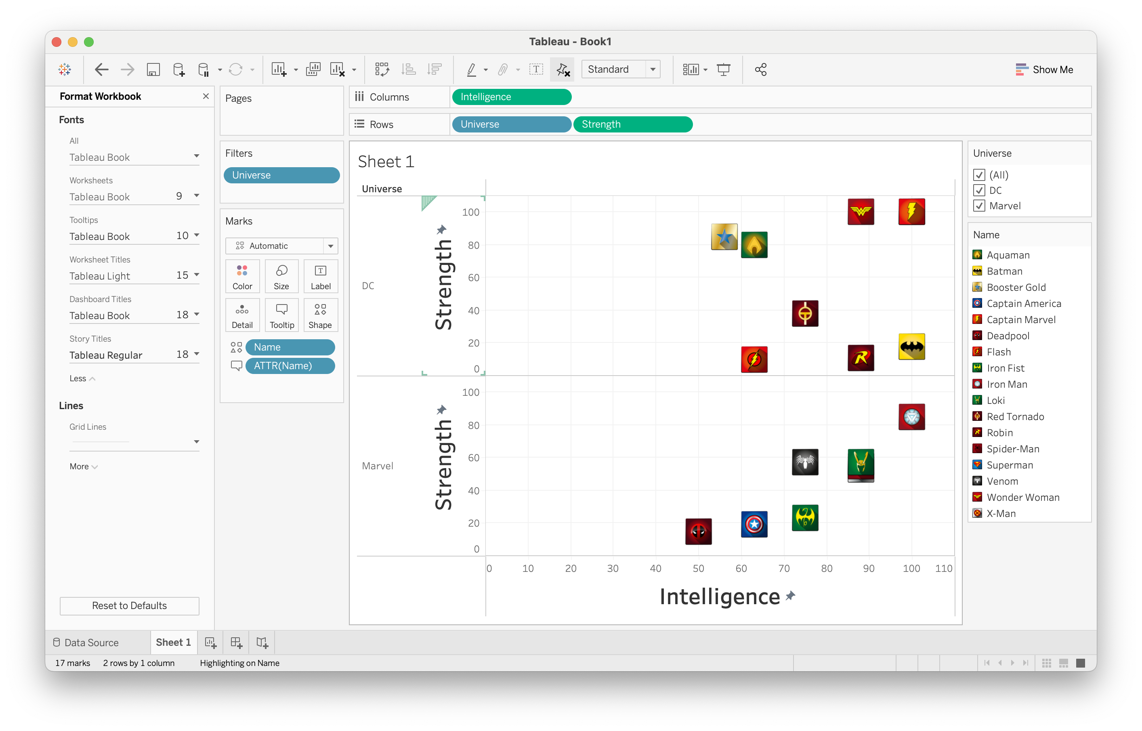
Adding background images

Slide 40
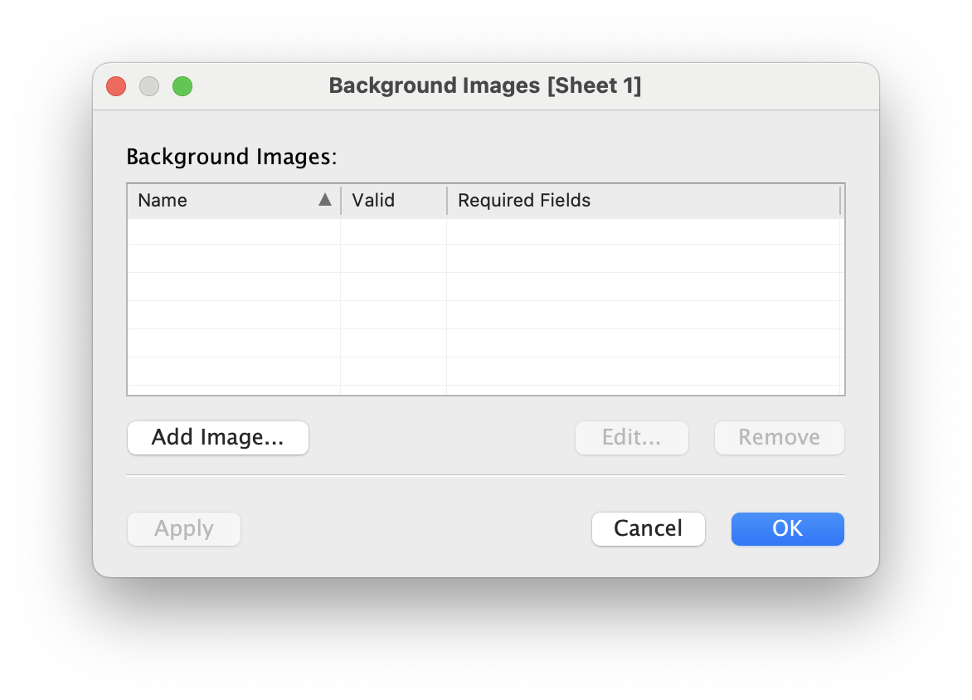
Adding background images

Slide 41
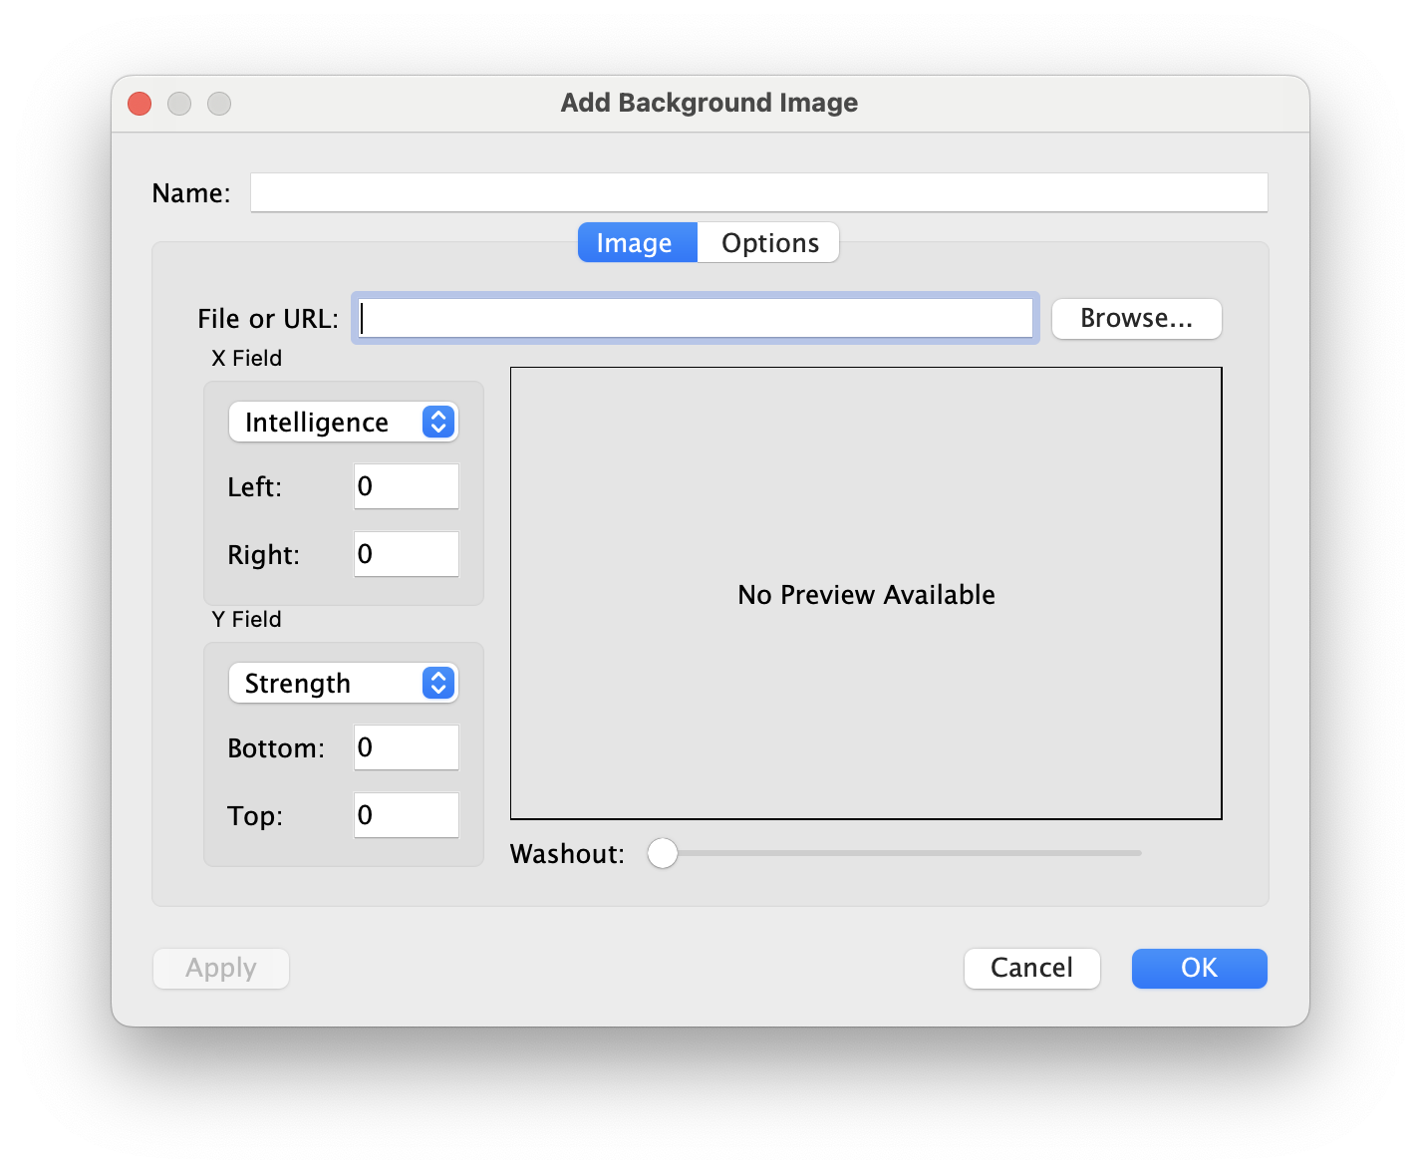
Adding background images

Slide 42
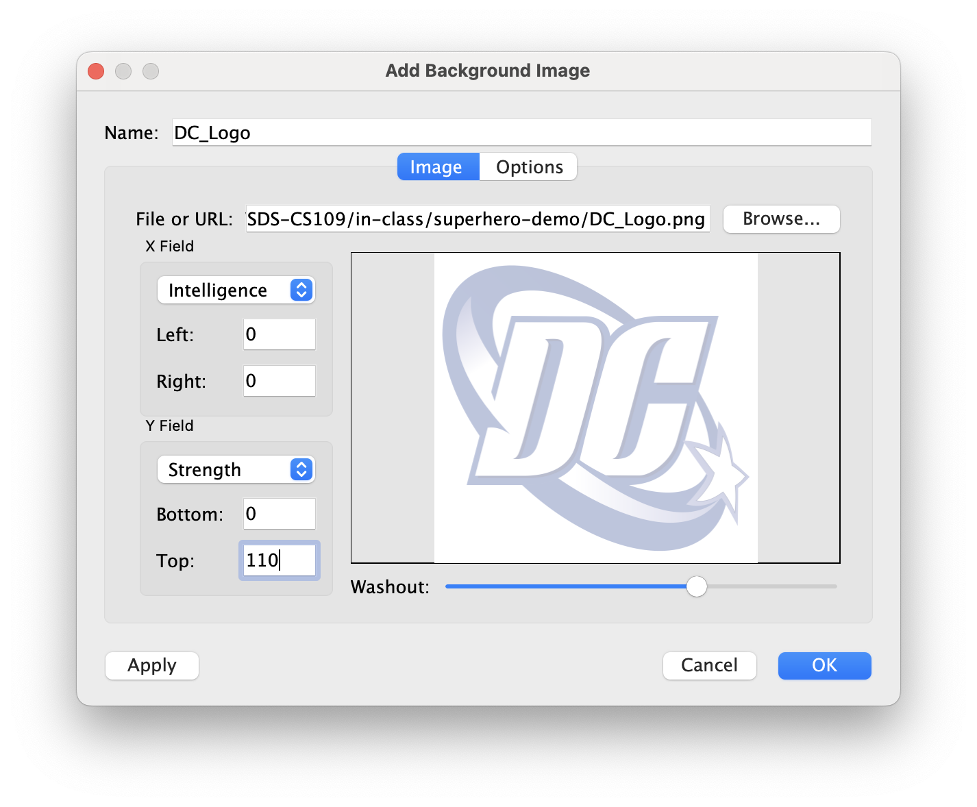
Adding background images

Slide 43
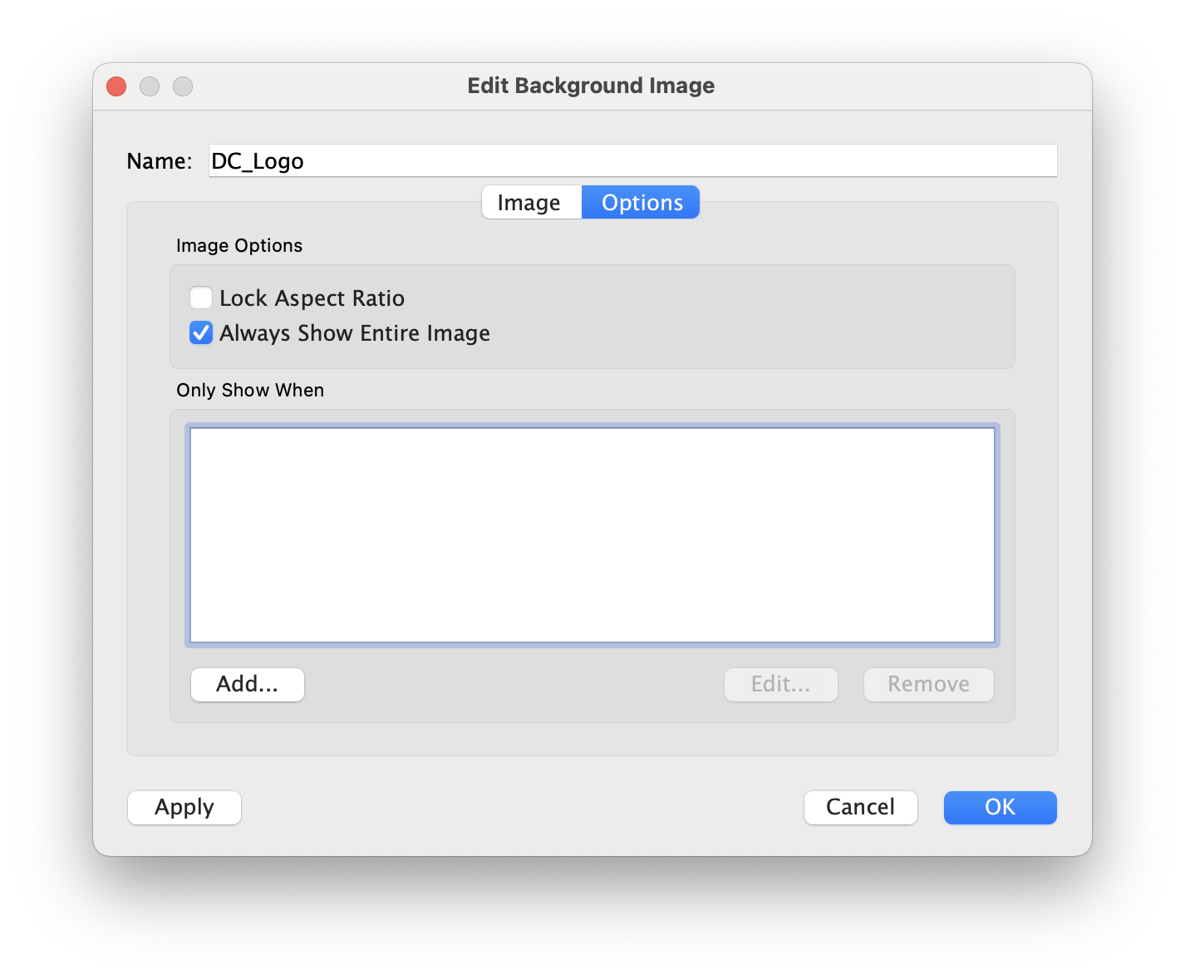
Adding background images

Slide 44
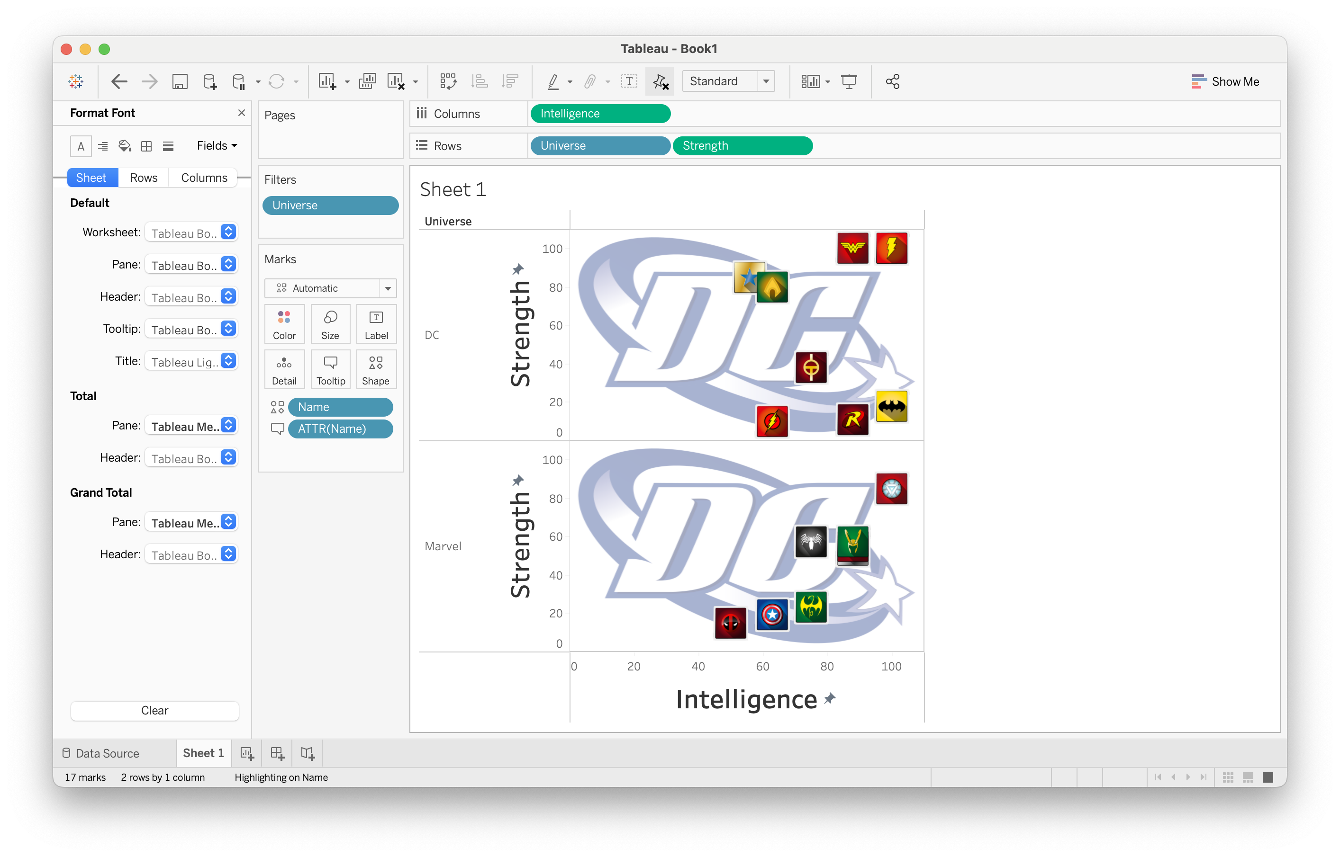
Adding background images

Slide 45
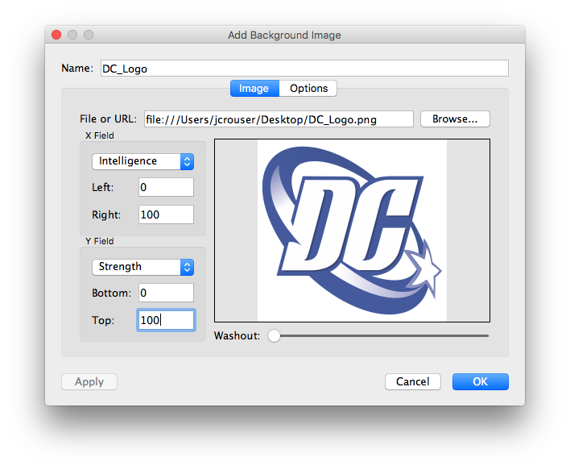
Adding background images

Slide 46
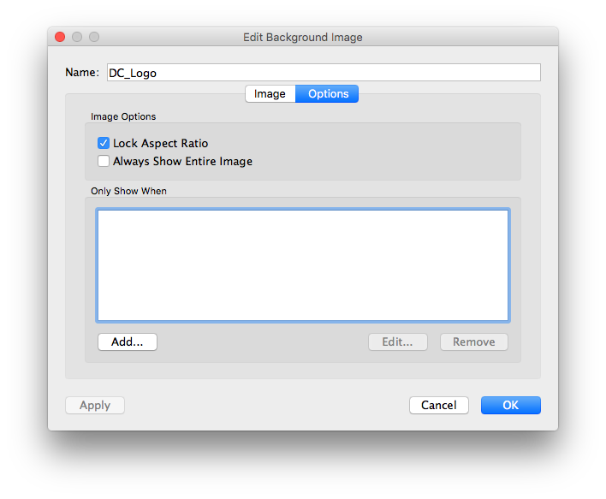
Adding background images

Slide 47
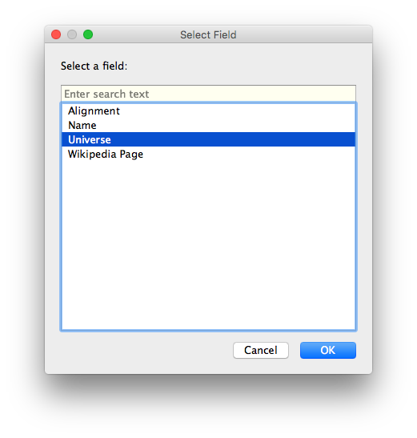
Adding background images

Slide 48
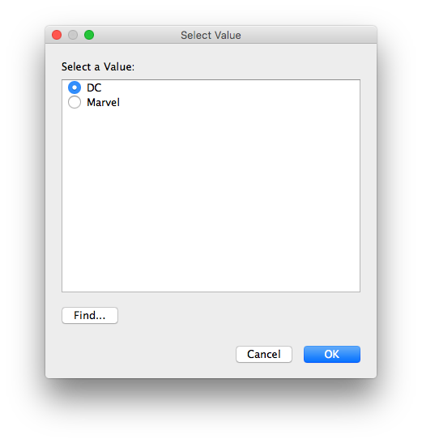
Adding background images

Slide 49

Adding background images

Slide 50

Adding background images

Slide 51

Adding background images

Slide 52

Adding background images

Slide 53

Customizing a dashboard

Slide 54
Customizing a dashboard

Slide 55

Customizing a dashboard

Slide 56

Customizing a dashboard

Slide 57

Flashback: dataset

Slide 58

Load external data on click

Slide 59

Load external data on click

Slide 60

Load external data on click

Slide 61

Load external data on click

Slide 62

Load external data on click

Slide 63


Load external data on click

Slide 64


Load external data on click

Slide 65

Load external data on click

Slide 66

Load external data on click

Slide 67


Load external data on click

Slide 68
Find your final project group.
Download Students.zip from the course website. The README explains the datasets included. Choose at least 2 datasets, join them in Tableau, and create a dashboard.
Meanwhile, Ab will come around and check in about final project proposals.
Your Turn!

